Slide 1
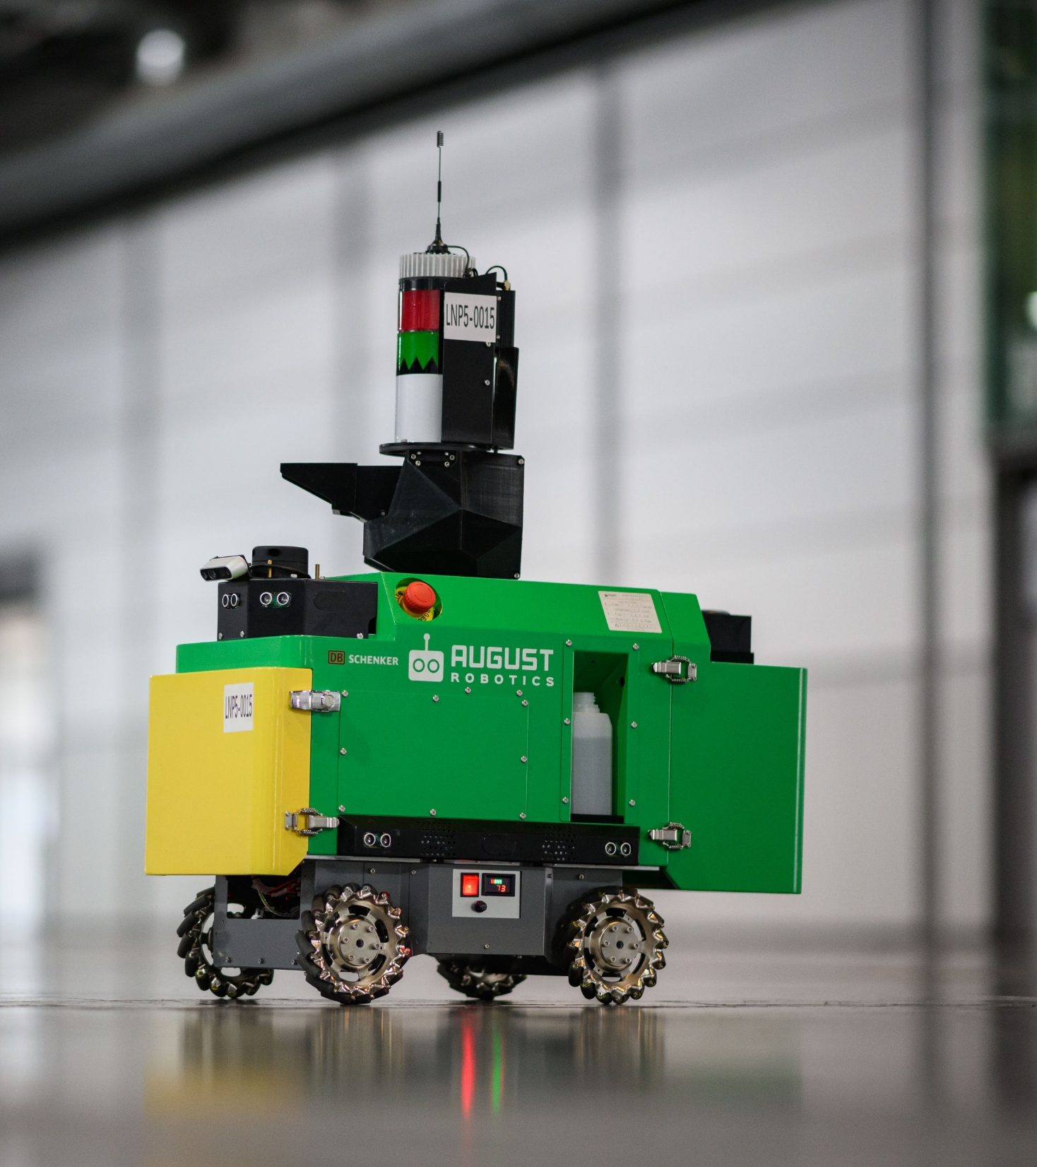

LIONEL
Training Course
Last updated March 2024 | Please go to the User Portal to download the latest version
Confidential – do not distribute

Slide 2
Contents
Updated since Jan 2022
In the office
On-site
Module 1
Module 2
Module 3
Overview
Page 10
Map Upload
Page 31
On-Site Preparation
Page 51
Module 4
Module 5
Module 6
Module 7
Equipment Set-Up
Page 78
Job Supervision
Page 129
Clean Up
Page 143
Proactive Care & Troubleshooting
Page 151

Slide 3


Module 0: Introduction
Lionel Training Course
Last updated March 2023 | Go to the User Portal to download the latest version
Confidential – do not distribute

Slide 4
This training course contains 7 modules
Updated since Jan 2022
Module 0: introduction
In the office
On-site
Module 1
Module 2
Module 3
Overview
Introducing the components of the Lionel system – Robot, Guiding Station, Reference Beacon, Map Server – and how they work together
Map Upload
Walking through how to use the User Portal to upload, process and edit your maps
On-Site Preparation
Demonstrating steps to take on-site before the job: charging batteries, opening the Map Server Box, syncing the latest map and preparing the paint
Module 4
Module 5
Module 6
Module 7
Equipment Set-Up
Demonstrating how to set up and calibrate the equipment on-site (the Reference Beacons, Guiding Station and Lionel Robot)
Job Supervision
Demonstrating how to use the Map Server to monitor Lionel as it marks your floors
Clean Up
Demonstrating the steps you need to take after Lionel completes a job to care for the equipment
Proactive Care & Troubleshooting
Demonstrating the proactive maintenance processes you need to perform and the common reactive troubleshooting methods

Slide 5



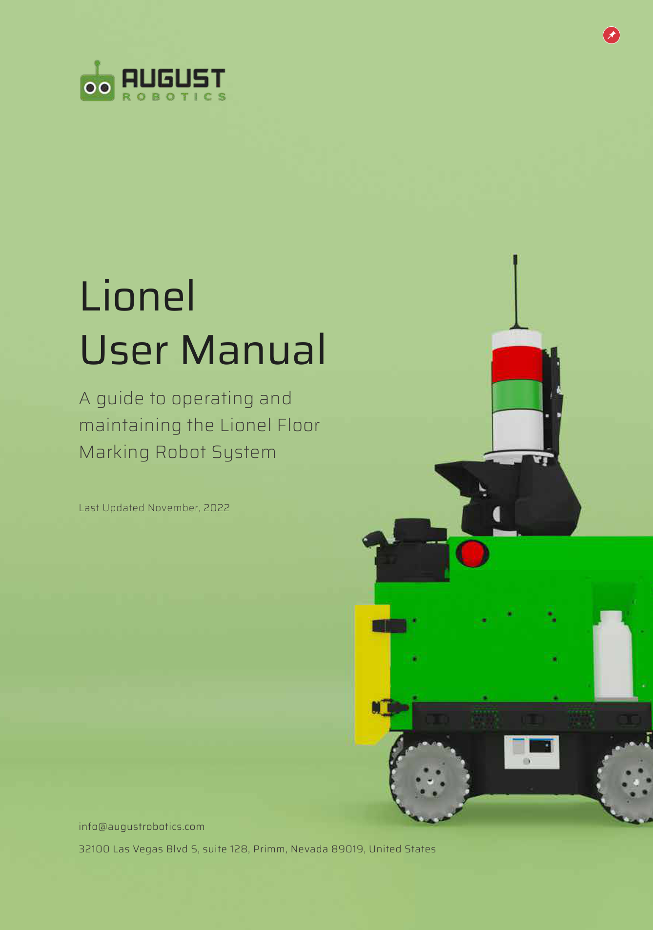
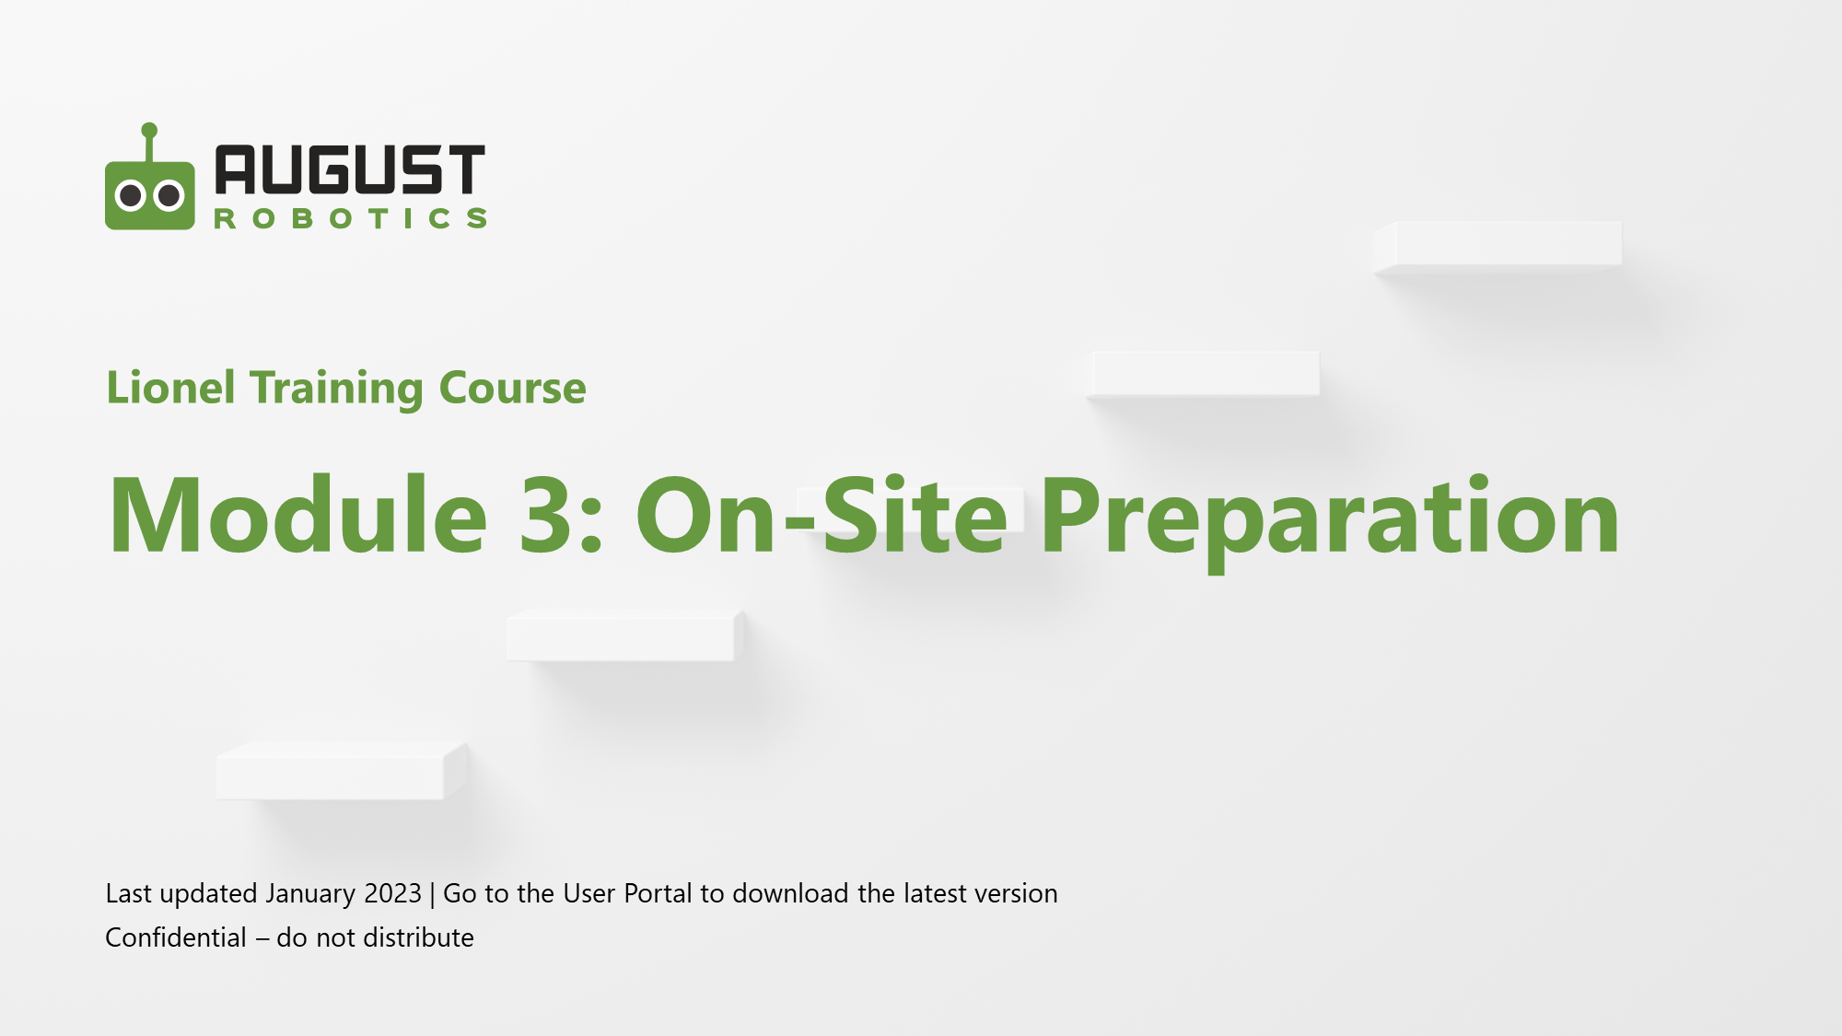
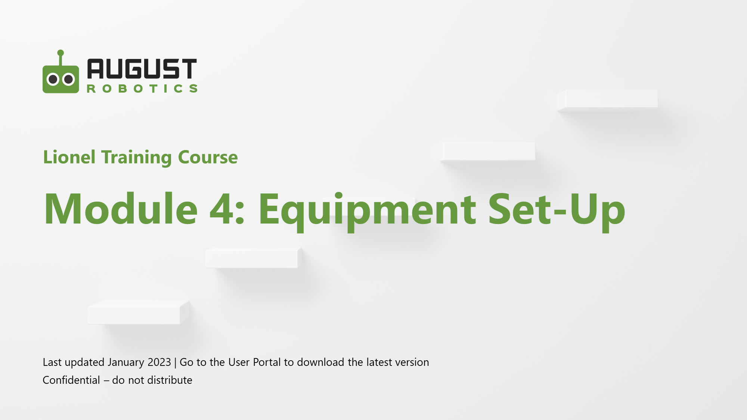

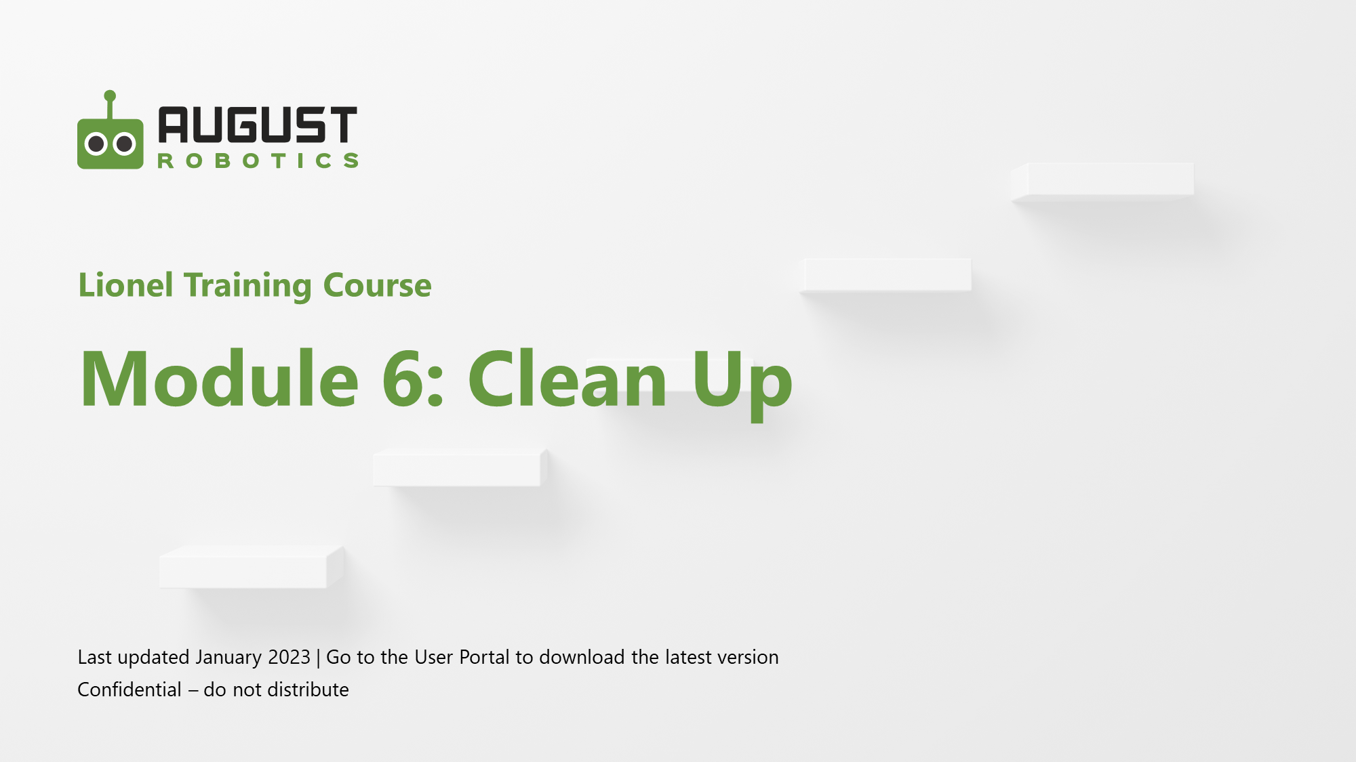
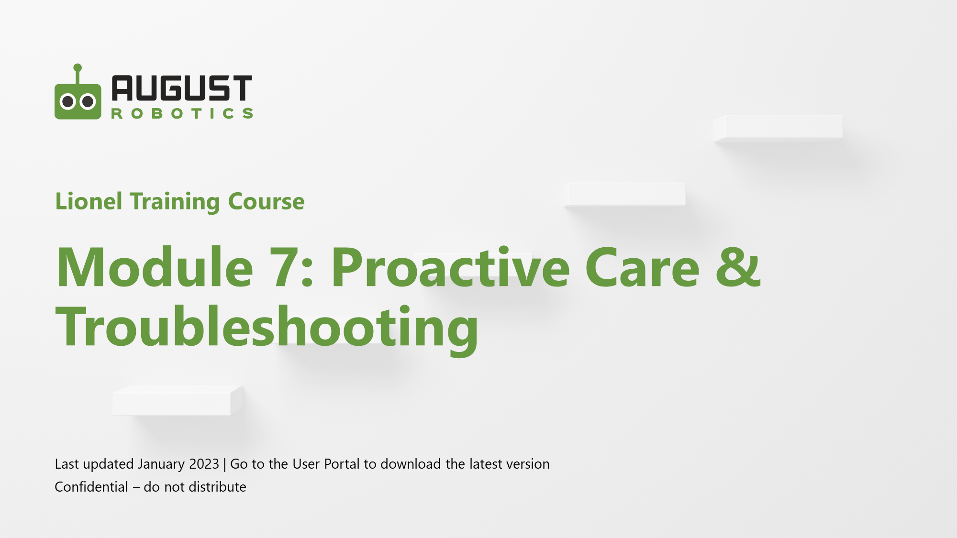
In addition to our training sessions, we will provide ongoing support
Updated since Jan 2022
Module 0: introduction
Your August Robotics representatives
Training Slides for All 7 Modules
User Manual
Detailed documentation of everything we will cover in the Zoom and on-site training
Concise summary of the key things you need to know
Engineer
Number
xxx@augustrobotics.com
Engineer
Number
xxx@augustrobotics.com
You can also reach out to our 24-hour support team at support@augustrobotics.com
[Monday - Friday]

Slide 6


August Robotics is a global leader in mobile robotics
Module 0: introduction
Our mission is to automate dirty, dangerous and dull jobs with user-friendly and affordable robots
Global footprint and dedicated in-market support
Pioneer with years of experience
2017
August Robotics founded
Mid 2019
First Lionel commercially deployed in Germany
Europe
Key customer service hub
United States
Key customer service hub
Asia
Commercial and robot development centre
Aug 2022
Lionel made its 100,000th mark
End 2022
Launch of lease offering – users can set up and operate Lionel without needing August Robotics’ engineers on-site

Slide 7





Lionel is August Robotics’ flagship solution
Module 0: introduction
Lionel is the smarter way to mark exhibition floors
Fast
A single robot makes an average of 80 marks per hour, allowing you to speed up floor marking and the exhibition set-up process
Autonomous
Once Lionel starts working, it is fully autonomous and requires minimal supervision, freeing you up for other activities
Accurate
Lionel marks with sub-5mm precision and without the accumulation of errors, resulting in a hassle-free perfect layout
Flexible
Lionel is purpose-built for exhibition layouts and can mark anything you need – booth corners, numbers, text and other symbols
Easy
Lionel can be used by anyone – no robotics or engineering experience is required

Slide 8
Module 1: Overview
Lionel Training Course
Last updated March 2024 | Go to the User Portal to download the latest version
Confidential – do not distribute

Slide 9
Where are we?
Updated since Jan 2022
Module 1: OVERVIEW
In the office
On-site
Module 1
Module 2
Module 3
Overview
Introducing the components of the Lionel system – Robot, Guiding Station, Reference Beacon, Map Server – and how they work together
Map Upload
Walking through how to use the User Portal to upload, process and edit your maps
On-Site Preparation
Demonstrating steps to take on-site before the job: charging batteries, opening the Map Server Box, syncing the latest map and preparing the paint
Module 4
Module 5
Module 6
Module 7
Equipment Set-Up
Demonstrating how to set up and calibrate the equipment on-site (the Reference Beacons, Guiding Station and Lionel Robot)
Job Supervision
Demonstrating how to use the Map Server to monitor Lionel as it marks your floors
Clean Up
Demonstrating the steps you need to take after Lionel completes a job to care for the equipment
Proactive Care & Troubleshooting
Demonstrating the proactive maintenance processes you need to perform and the common reactive troubleshooting methods

Slide 10
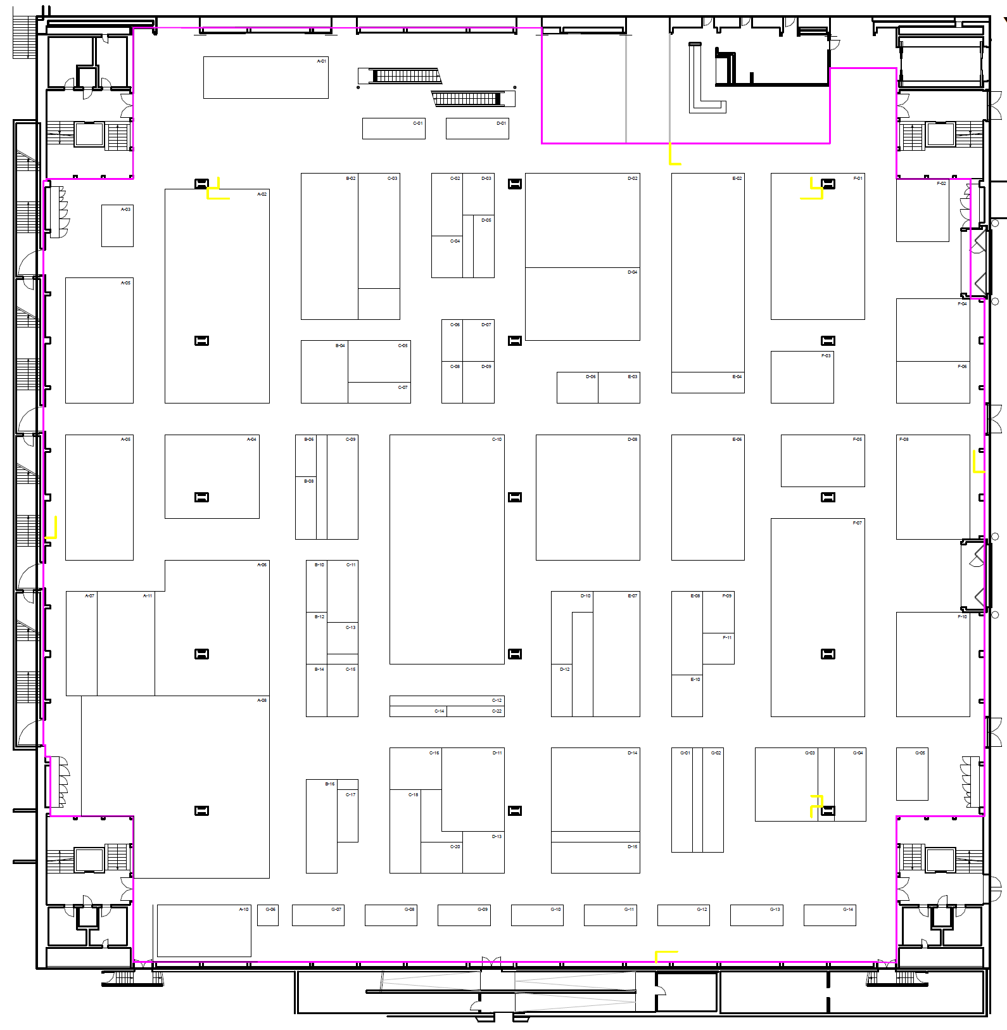
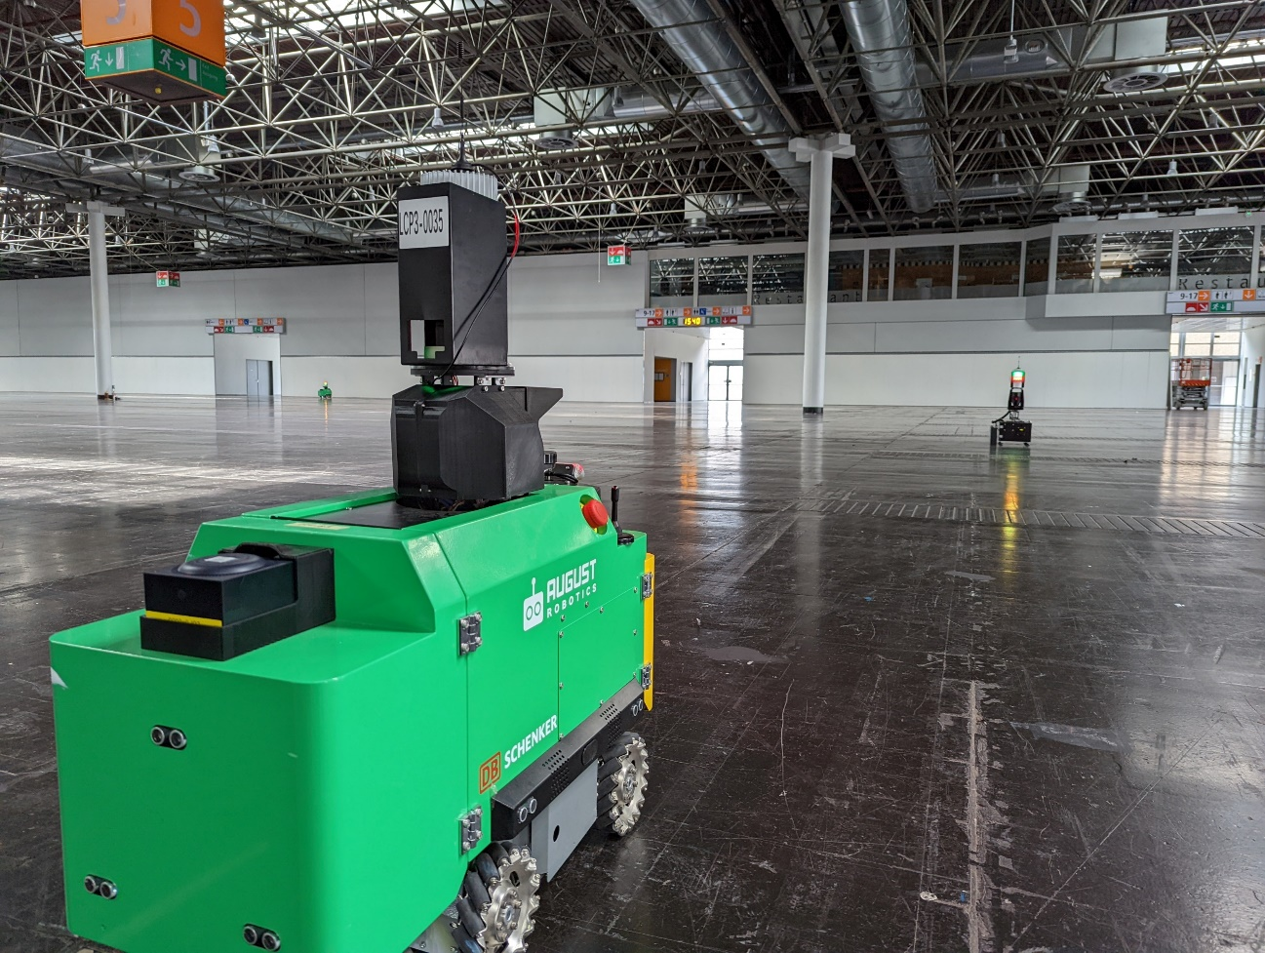
The Lionel system takes your digital floor plan…
Module 1: OVERVIEW

Slide 11
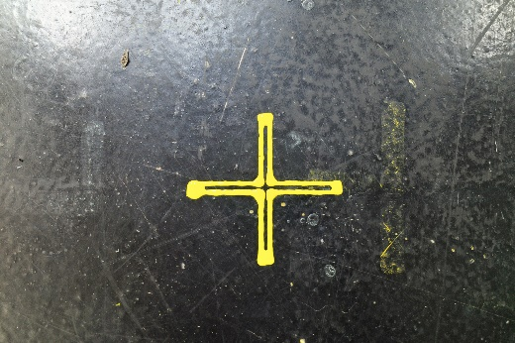
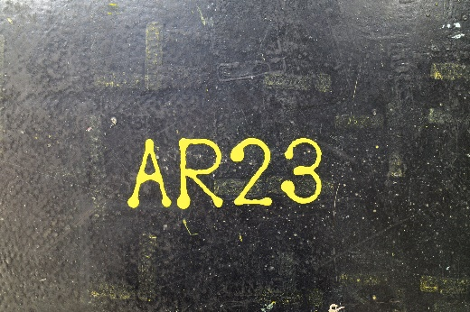

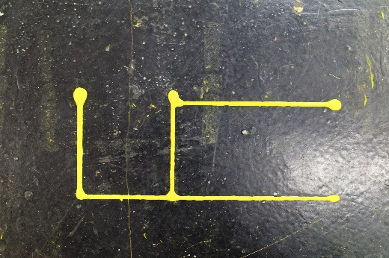
… and marks the essential information on the physical floor
Module 1: OVERVIEW
Lionel can mark anything, as its spray mechanism has a full range of motion. The most common marks
Booth corners
Booth numbers
B02
B03
A02
A05
A05
A04
Electricity marks
Other

Slide 12
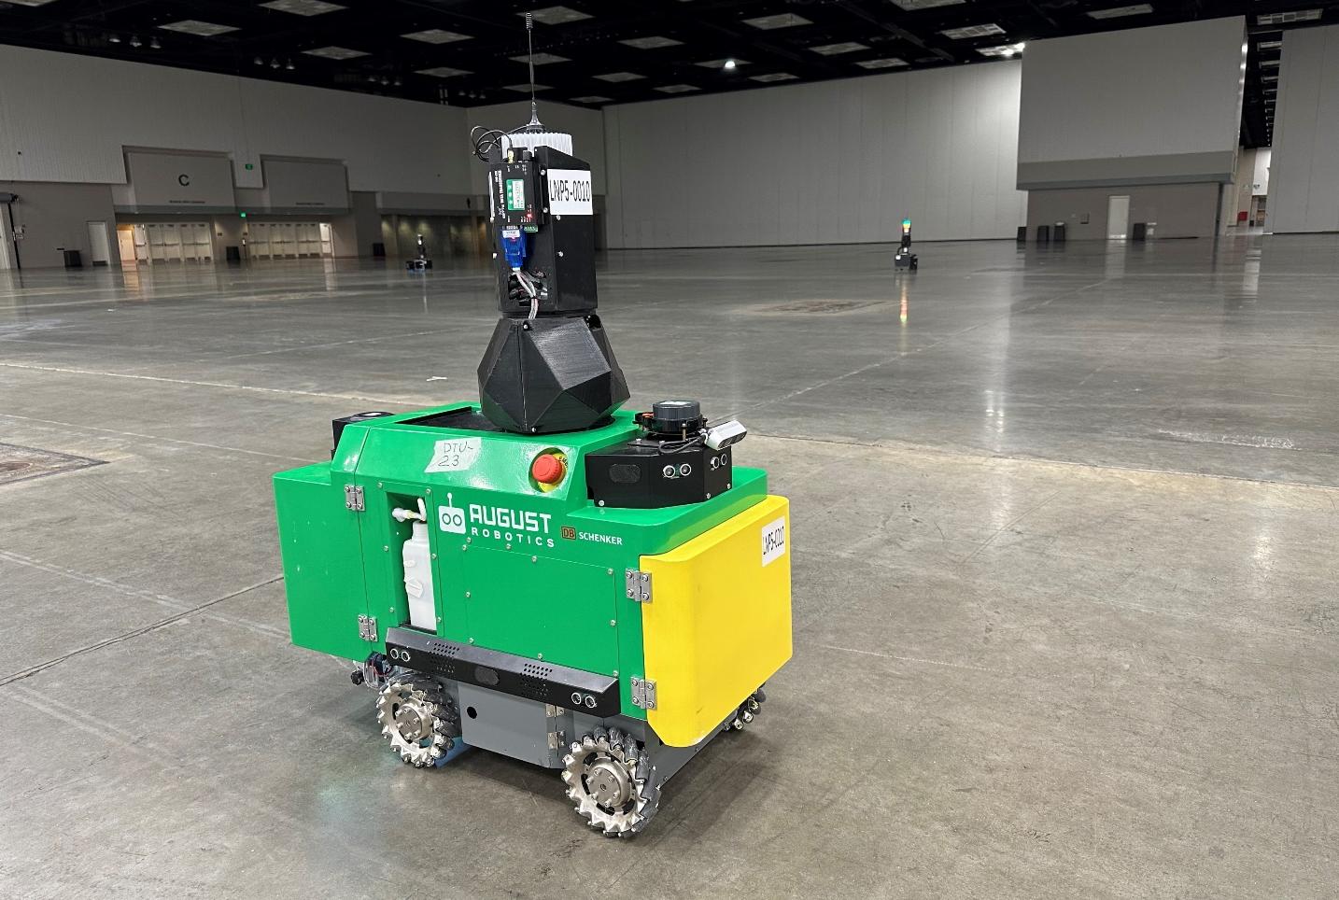
How does the system work?
Module 1: OVERVIEW
0
Determine Reference Points for the hall
1
Open the Map Server
2
Set up the two Reference Beacons
3
Set up and calibrate the Guiding Station
4
Set up and calibrate the Lionel robot
5
Run the job

Slide 13

How does the system work on-site?
Module 1: OVERVIEW
0
Determine Reference Points for the hall
We put down two Reference Points in every hall.
The points will typically be close to a prominent feature in the hall (such as a wall or a pillar), and will be physically marked before the job day (e.g. with a nail in the floor)
The Reference Points allow us to “match” the digital plan with the physical environment
1
Open the Map Server
2
Set up the two Reference Beacons
3
Set up and calibrate the Guiding Station
Reference Point
Reference Point
4
Set up and calibrate the Lionel robot
5
Run the job
We will cover the detailed equipment set-up process in detail in Module 4

Slide 14
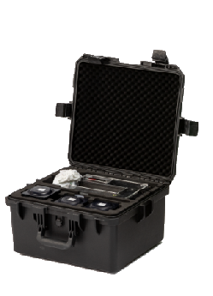

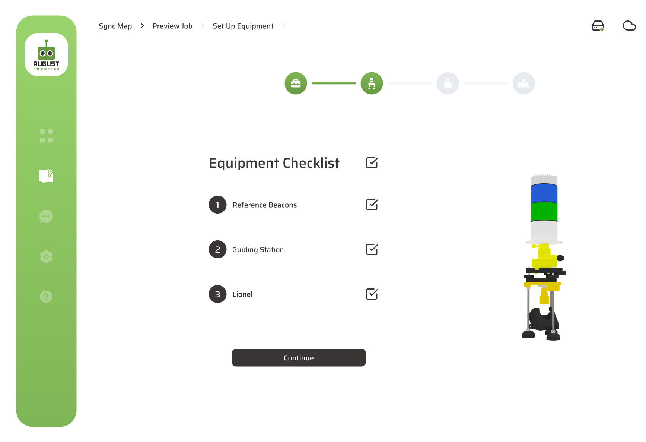
How does the system work on-site?
Module 1: OVERVIEW
0
Determine Reference Points for the hall
On the job day, the user opens the Map Server and its Tablet, selects the show to mark, and follows the instructions on the Tablet to set up the equipment
1
Open the Map Server
2
Set up the two Reference Beacons
3
Set up and calibrate the Guiding Station
Reference Point
Reference Point
4
Set up and calibrate the Lionel robot
5
Run the job
We will cover the detailed equipment set-up process in detail in Module 4

Slide 15
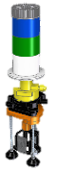
How does the system work on-site?
Module 1: OVERVIEW
0
Determine Reference Points for the hall
On the job day, a Reference Beacon is placed over each Reference Point
1
Open the Map Server
2
Set up the two Reference Beacons
Reference Beacon
Reference Beacon
3
Set up and calibrate the Guiding Station
Reference Point
Reference Point
4
Set up and calibrate the Lionel robot
5
Run the job
We will cover the detailed equipment set-up process in detail in Module 4

Slide 16
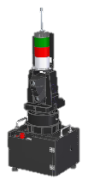

How does the system work on-site?
Module 1: OVERVIEW
0
Determine Reference Points for the hall
Then, a Guiding Station is placed in the hall, somewhere where it has line of sight to both Reference Beacons
By measuring its distance to the Reference Beacons, the Guiding Station can determine its position
After this, the Reference Beacons are no longer required
1
Open the Map Server
Guiding Station
2
Set up the two Reference Beacons
Reference Beacon
Reference Beacon
3
Set up and calibrate the Guiding Station
Reference Point
Reference Point
4
Set up and calibrate the Lionel robot
5
Run the job
We will cover the detailed equipment set-up process in detail in Module 4

Slide 17
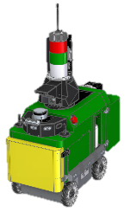
How does the system work on-site?
Module 1: OVERVIEW
0
Determine Reference Points for the hall
Then, the Lionel robot is set up and placed on the floor, somewhere where it has line of sight to the Guiding Station
By measuring its distance and rotational angle to the Guiding Station, the Lionel robot can determine its position
1
Open the Map Server
2
Set up the two Reference Beacons
Lionel Robot
Guiding Station
3
Set up and calibrate the Guiding Station
4
Set up and calibrate the Lionel robot
5
Run the job
We will cover the detailed equipment set-up process in detail in Module 4

Slide 18
How does the system work on-site?
Module 1: OVERVIEW
0
Determine Reference Points for the hall
Lionel can now start marking marks
The Guiding Station acts as a lighthouse for Lionel throughout the job. Lionel communicates with the Guiding Station to ensure its position is accurate before placing each mark
1
Open the Map Server
2
Set up the two Reference Beacons
Lionel Robot
Guiding Station
3
Set up and calibrate the Guiding Station
4
Set up and calibrate the Lionel robot
5
Run the job
We will cover the detailed equipment set-up process in detail in module 4

Slide 19
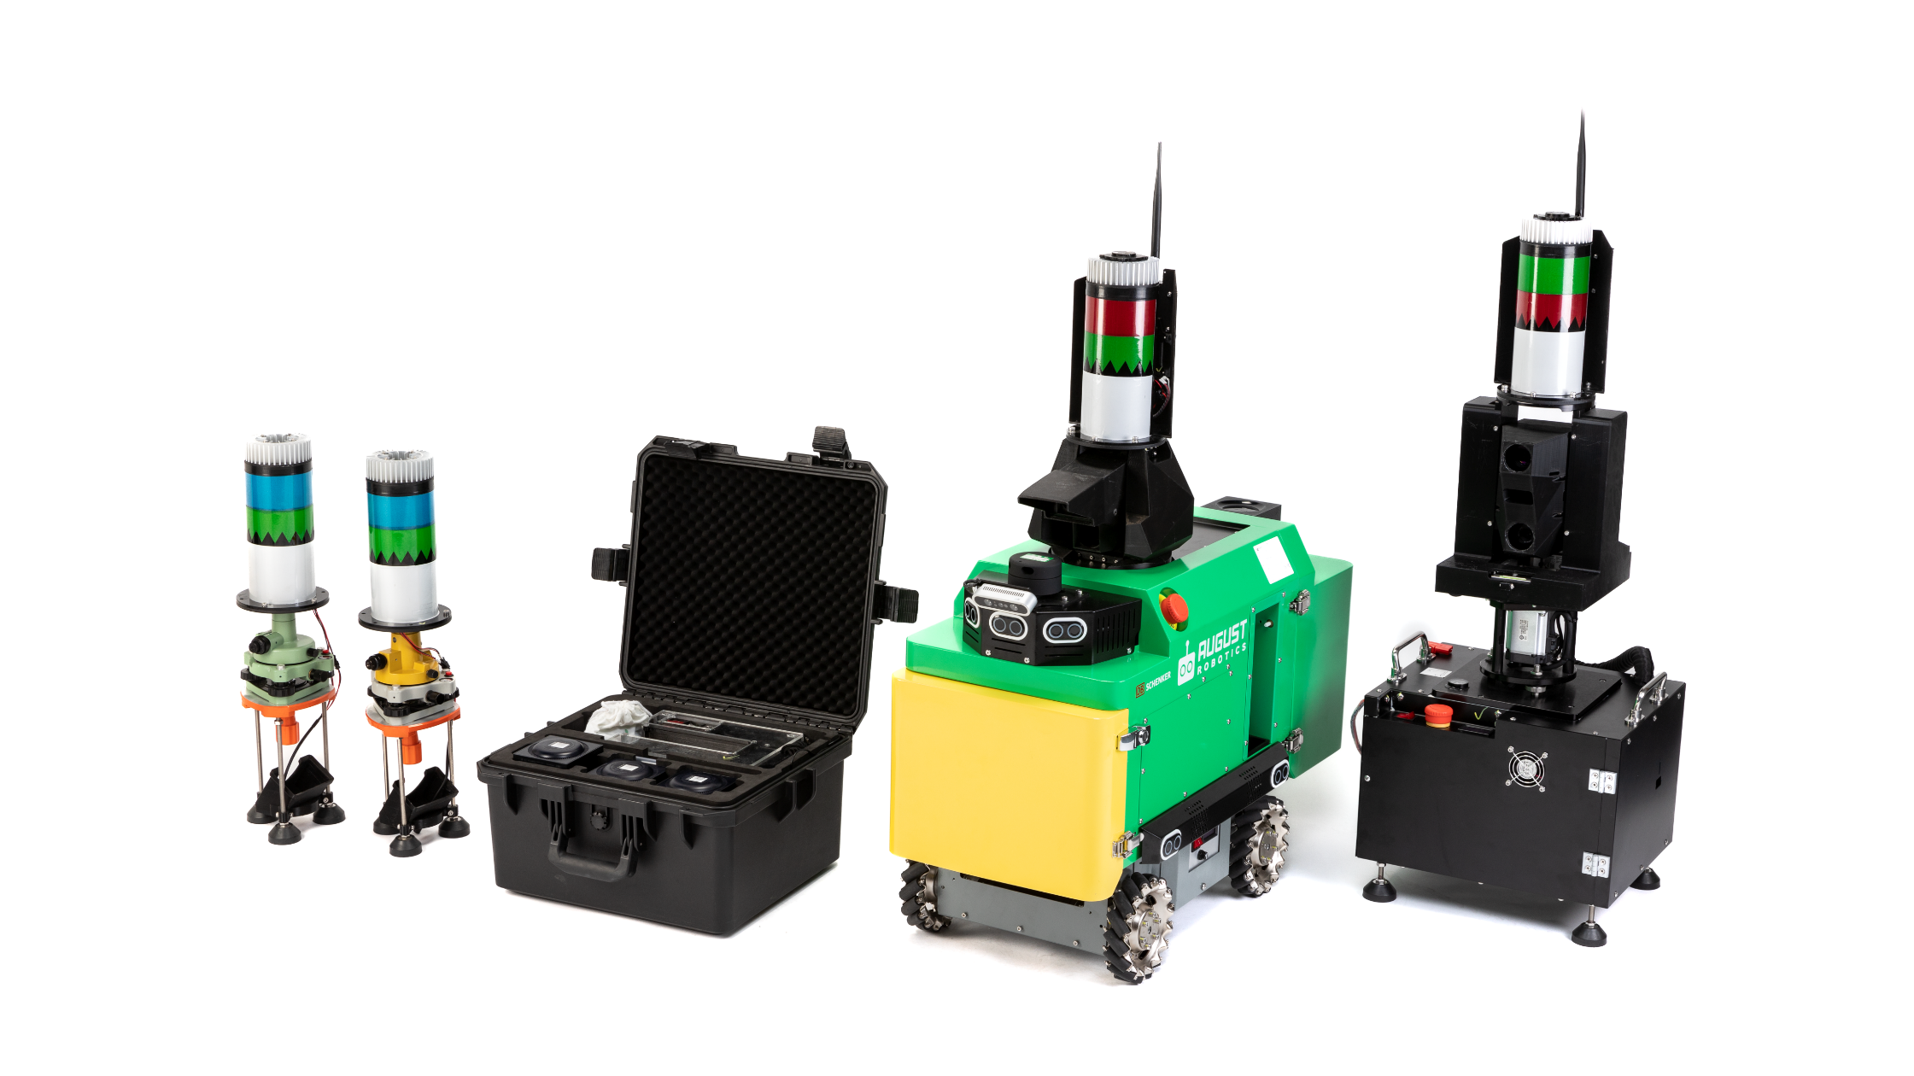
Appendix: The four key pieces of hardware
Module 1: OVERVIEW

Slide 20
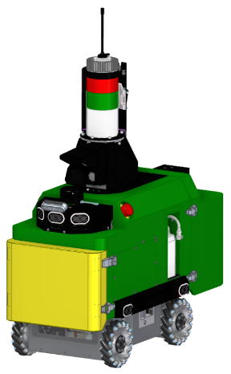
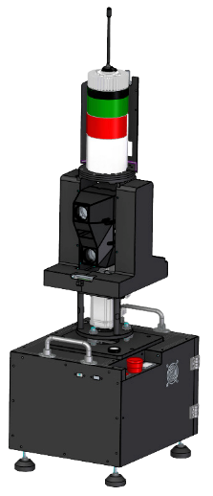
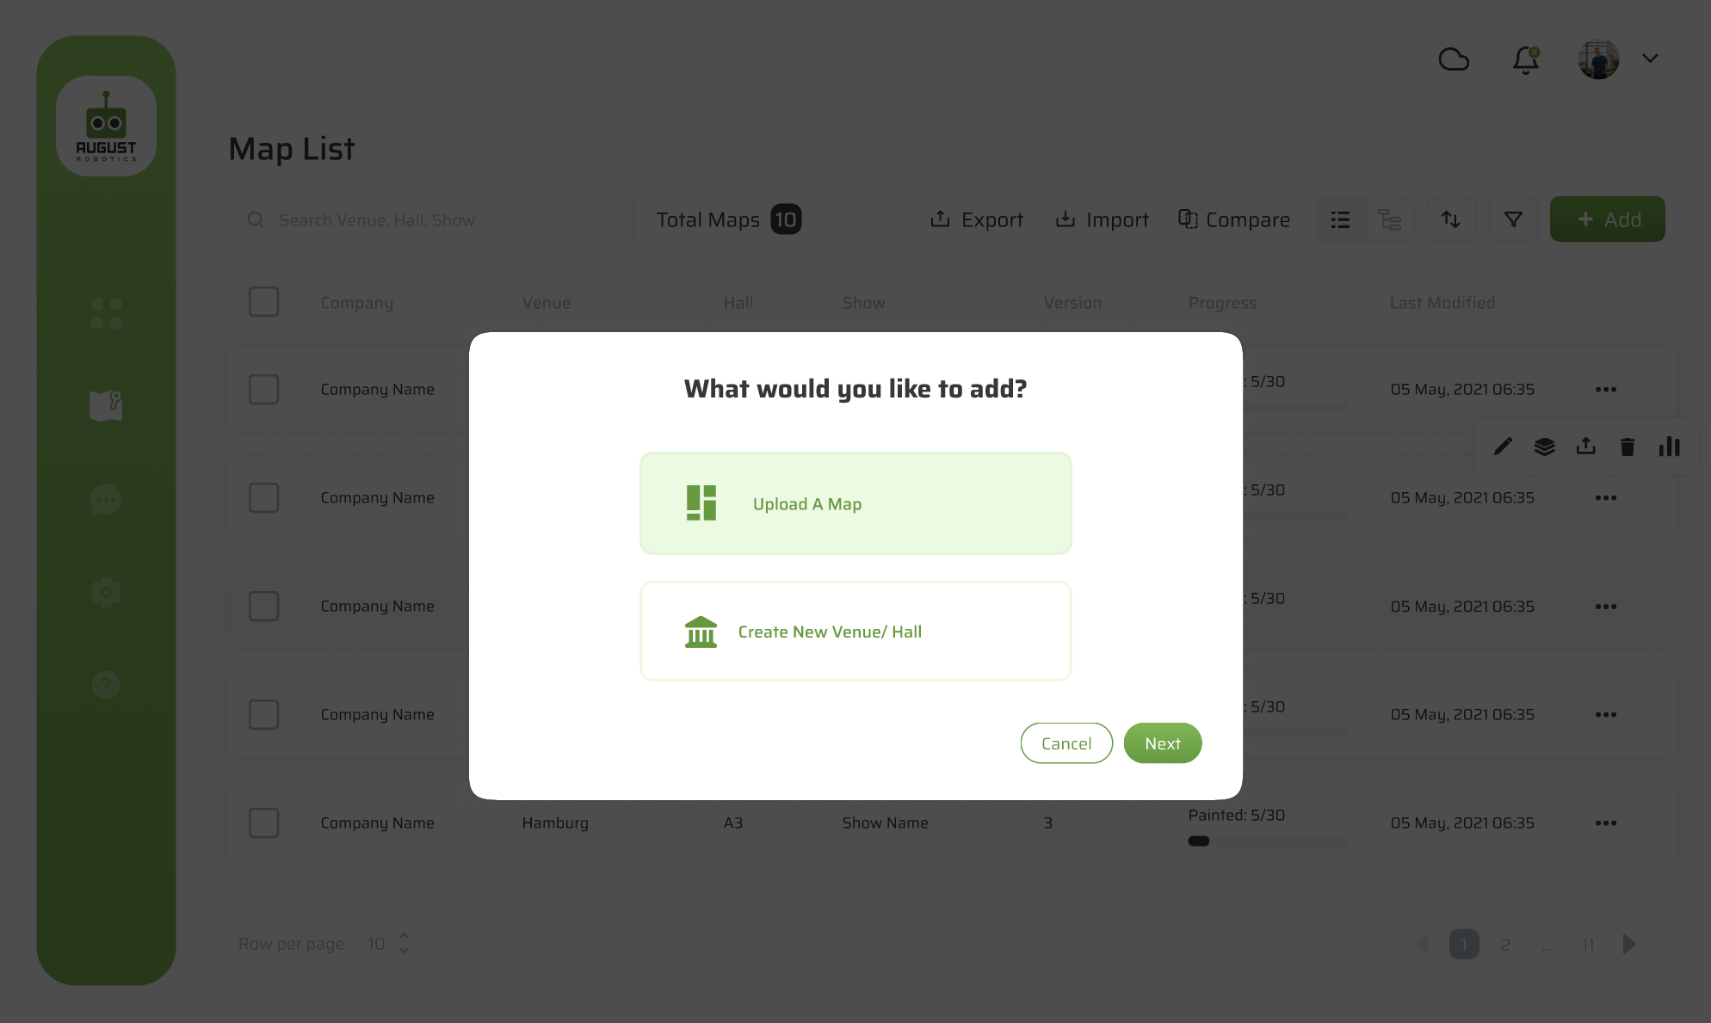
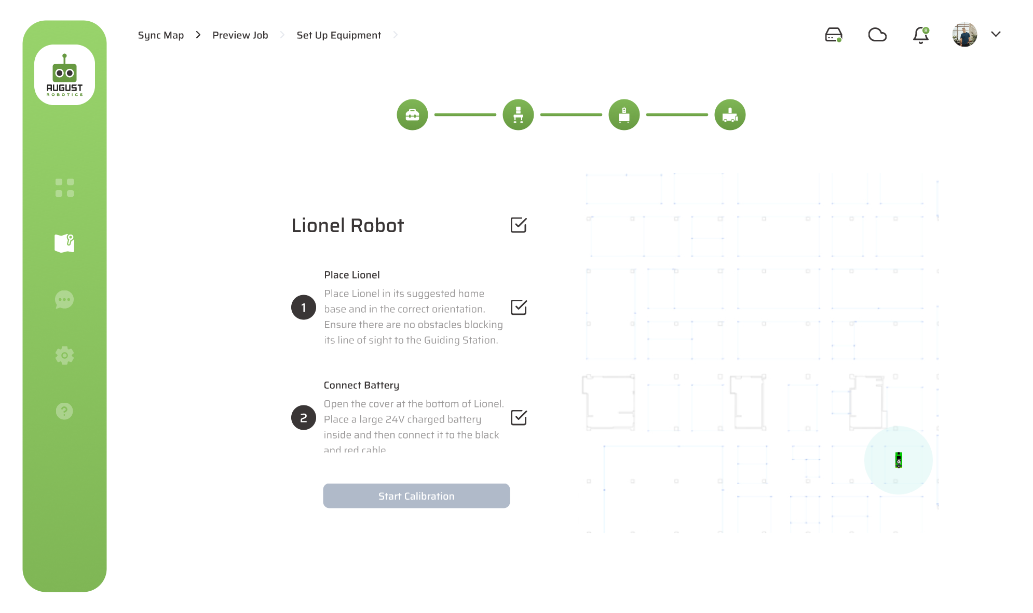

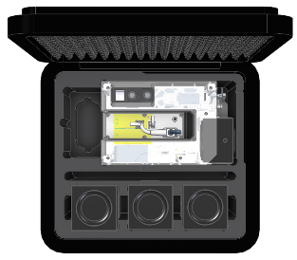
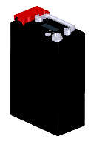
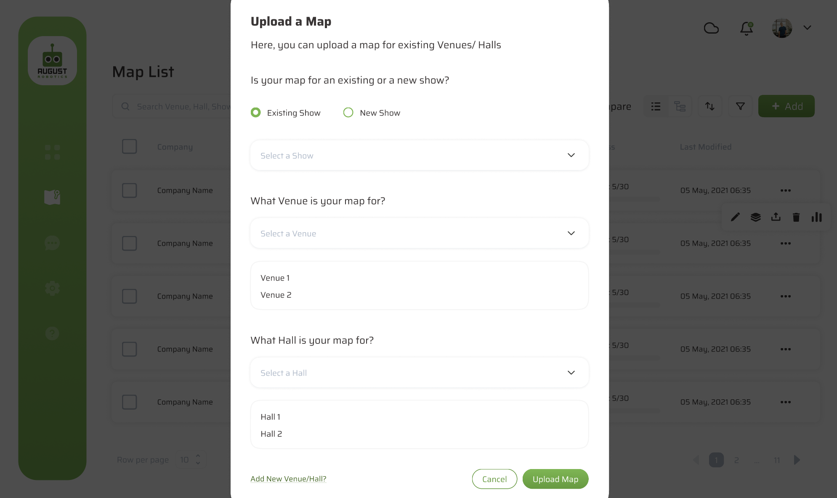
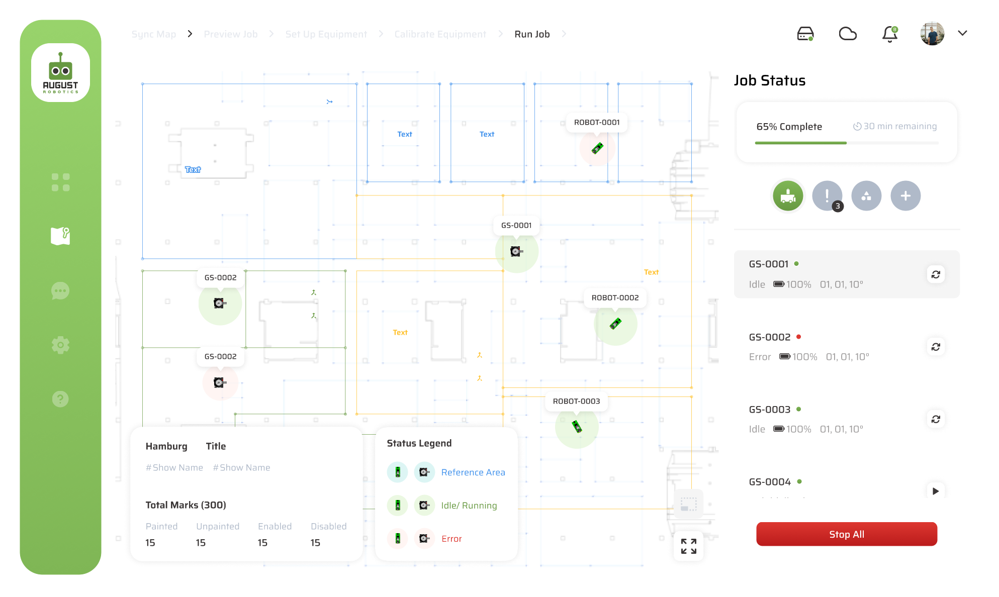
The Lionel system includes hardware and software components
Module 1: OVERVIEW
Hardware
Software
Lionel Robot
Guiding Station
Reference Beacons
Other Equipment
Map Server Box
User Portal
Map Server Interface

Slide 21
The Lionel system includes hardware and software components
Module 1: OVERVIEW
Hardware
Software
Lionel Robot
Guiding Station
Reference Beacons
Other Equipment
Map Server Box
User Portal
Map Server Interface
Four-wheeled robot that autonomously moves, localises and makes floor markings in exhibition halls
A stationary piece of equipment that helps the robot to understand its location in the hall to place marks accurately
Two beacons placed on reference points in the hall during the set-up process to allow the Guiding Station to calculate its position
Other physical items required on-site, such as batteries, paint preparation materials and maintenance kit
A physical box that contains a PC (the “brain” of the system), routers, and a tablet with the Map Server Interface; allows on-site operators to set up and run the job
A system that the CAD team uses before the day of the job to upload the maps and have them automatically processed for the Lionel system
A system that the CAD team and on-site operators use to retrieve maps, set up the physical equipment and run the floor marking job
This module will introduce the hardware of the Lionel system. Later modules will walk through how to set up the software and hardware

Slide 22
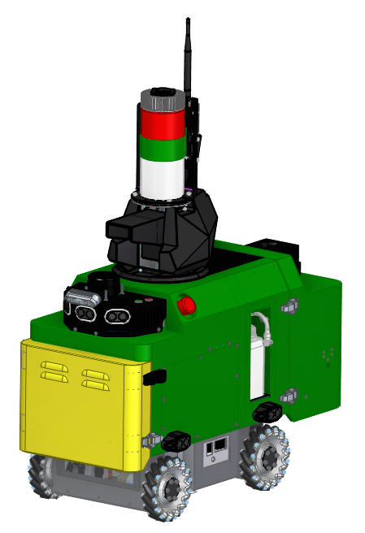
Lionel Robot: overview of parts
Updated since Jan 2022
Module 1: OVERVIEW
Lionel is a four-wheeled robot that autonomously moves, localises and makes floor markings in exhibition halls
Camera Beacon
to enable the Guiding Station to locate Lionel and guide it to the accurate position
Mesh Router
to enable the robot to communicate with the Map Server
Multiple Sensors
for intelligent and safe navigation in busy environments
Spray Marking Mechanism
that can make any type of mark on any type of ground surface
Battery holder
to connect and hold pre-charged batteries
AI Powered Marking Camera
to validate the quality of marks
Maintenance Door
to enable reactive troubleshooting and proactive maintenance
Paint Tank
to store the paint required for marking
Mobile Base
with omnidirectional wheels for flexible and agile movement
Emergency Stop
to stop the robot in emergency situations

Slide 23
Lionel Robot: the parts you interact with day-to-day
Updated since Jan 2022
Module 1: OVERVIEW
Camera Beacon
to enable the Guiding Station to locate Lionel and guide it to the accurate position
Mesh Router
to enable the robot to communicate with the Map Server
Multiple Sensors
for intelligent and safe navigation in busy environments
Spray Marking Mechanism
that can make any type of mark on any type of ground surface
Battery holder
to connect and hold pre-charged batteries
AI Powered Marking Camera
to validate the quality of marks
Maintenance Door
to enable reactive troubleshooting and proactive maintenance
Paint Tank
to store the paint required for marking
Mobile Base
with omnidirectional wheels for flexible and agile movement
Emergency Stop
to stop the robot in emergency situations

Slide 24
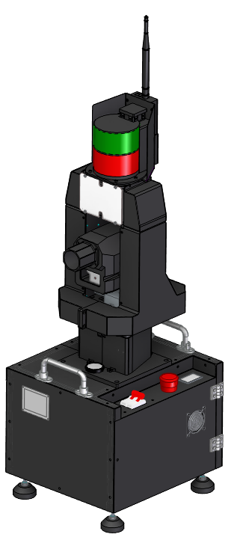
The Guiding Station
Updated since Jan 2022
Module 1: OVERVIEW
The Guiding Station enables Lionel to understand and adjust its location
The Guiding Station is placed in a fixed and known location in the hall
As the robot moves around the hall, the Guiding Station uses its camera beacon and laser to ascertain Lionel’s location
This enables Lionel to understand and adjust its position, and to place marks with high accuracy
Camera beacon
Mesh router (not visible)
Cameras
Motor
Levelling bubble
E-Stop
Power switch

Slide 25
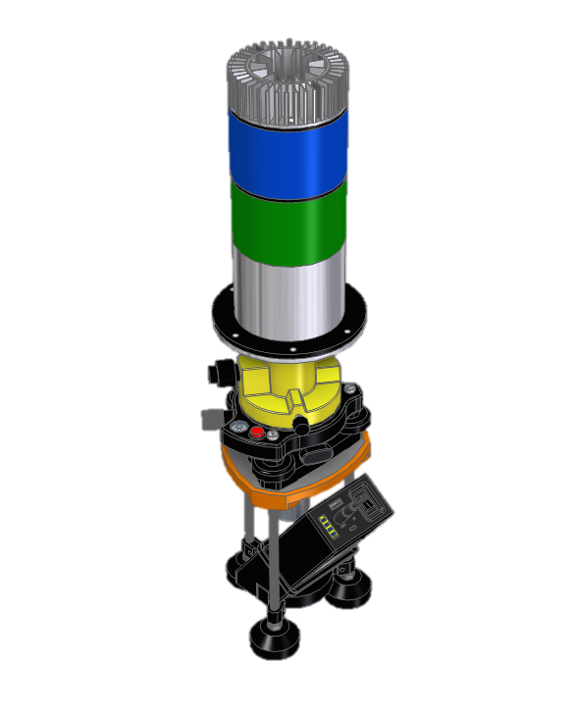
The Reference Beacons
Module 1: OVERVIEW
The two Reference Beacons enable the Guiding Station to calculate its position
During the set-up process, each Reference Beacon is precisely placed in a pre-defined reference location in the hall
The Guiding Station will calculate its position relative to the Reference Beacons, and thereby calculate its own position in the hall
After the set-up process, the Reference Beacons can be removed, unless additional Guiding Stations need to be added
LED beacon
Levelling screws
Levelling bubble
Red laser switch
Battery
Laser light (not visible)

Slide 26
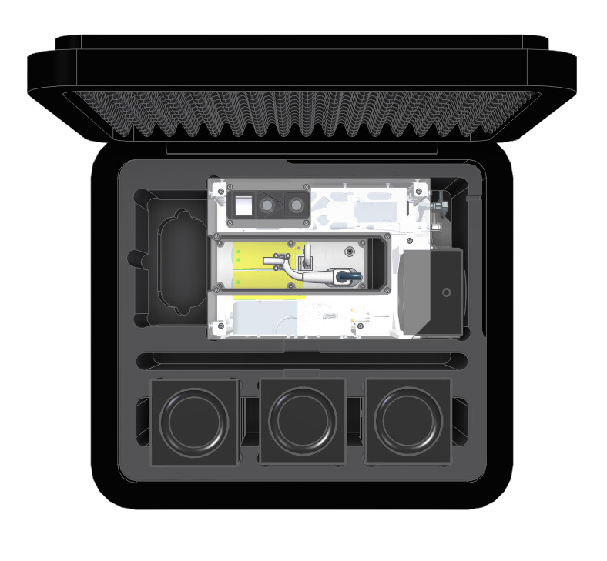
The Map Server Box
Module 1: OVERVIEW
The Map Server is the “brain” of the Lionel system and connects all the components of the system
The Map Server Box refers to a physical black box (shown here)
Tablet with Map Server Interface
that on-site operators use to access the Map Server Interface
Power switch
to turn on the Map Server box
Map Server
the “brain” that controls the equipment in the system
Accessory Bag
with seven cords and accessories
Mesh Routers
that are connected to the robot and Guiding Station to establish communication within the system

Slide 27
Appendix: Lionel Robot Technical Specifications
Updated Jul 2023
Updated again March 2024
Module 1: OVERVIEW
Lionel is a four-wheeled robot that autonomously moves, localises and makes floor markings in exhibition halls
Weight
48 kg
Footprint
82 cm long, 40 cm wide, 113 cm tall
Localisation Accuracy
+ / - 5mm accuracy (default accuracy)
Speed
Maximum speed 1.2 m/s
Battery life
10 hours (additional batteries can be pre-charged)
Battery charging time
5 hours
Battery
24V voltage, 30Ah capacity
Marking method
Either permanent or washable paint
Payload
1L of paint
Temperature
Can work between 0 and 40 degrees Celsius

Slide 28
Appendix: Guiding Station Technical Specifications
Updated Jul 2023
Updated again March 2024
Module 1: OVERVIEW
The Guiding Station enables Lionel to understand and adjust its location
Weight
21 kg
Footprint
38 cm long, 38 cm wide, 120 cm tall
Localisation Accuracy
+ / - 5mm accuracy (default accuracy)
Localisation Range
Optimal range within 60m, maximum range 80m
Battery life
12 hours (additional batteries can be pre-charged)
Battery charging time
5 hours
Battery
24V voltage, 30Ah capacity
Temperature
Can work between 0 and 40 degrees Celsius

Slide 29
Module 2: Map Upload
Module completely refreshed in March 2024
Lionel Training Course
Last updated March 2024 | Go to the User Portal to download the latest version
Confidential – do not distribute

Slide 30
Where are we?
Updated since Jan 2022
MODULE 2: MAP UPLOAD AND SYNC
In the office
On-site
Module 1
Module 2
Module 3
Overview
Introducing the components of the Lionel system – Robot, Guiding Station, Reference Beacon, Map Server – and how they work together
Map Upload
Walking through how to use the User Portal to upload, process and edit your maps
On-Site Preparation
Demonstrating steps to take on-site before the job: charging batteries, opening the Map Server Box, syncing the latest map and preparing the paint
Module 4
Module 5
Module 6
Module 7
Equipment Set-Up
Demonstrating how to set up and calibrate the equipment on-site (the Reference Beacons, Guiding Station and Lionel Robot)
Job Supervision
Demonstrating how to use the Map Server to monitor Lionel as it marks your floors
Clean Up
Demonstrating the steps you need to take after Lionel completes a job to care for the equipment
Proactive Care & Troubleshooting
Demonstrating the proactive maintenance processes you need to perform and the common reactive troubleshooting methods

Slide 31
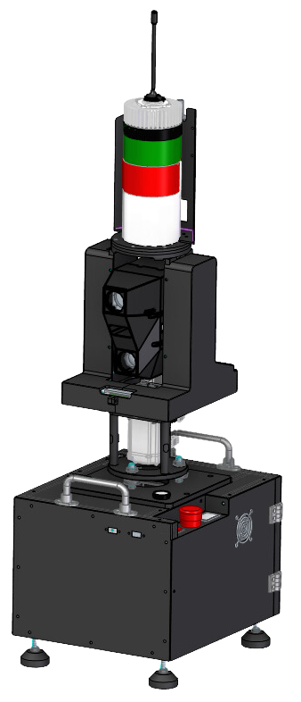
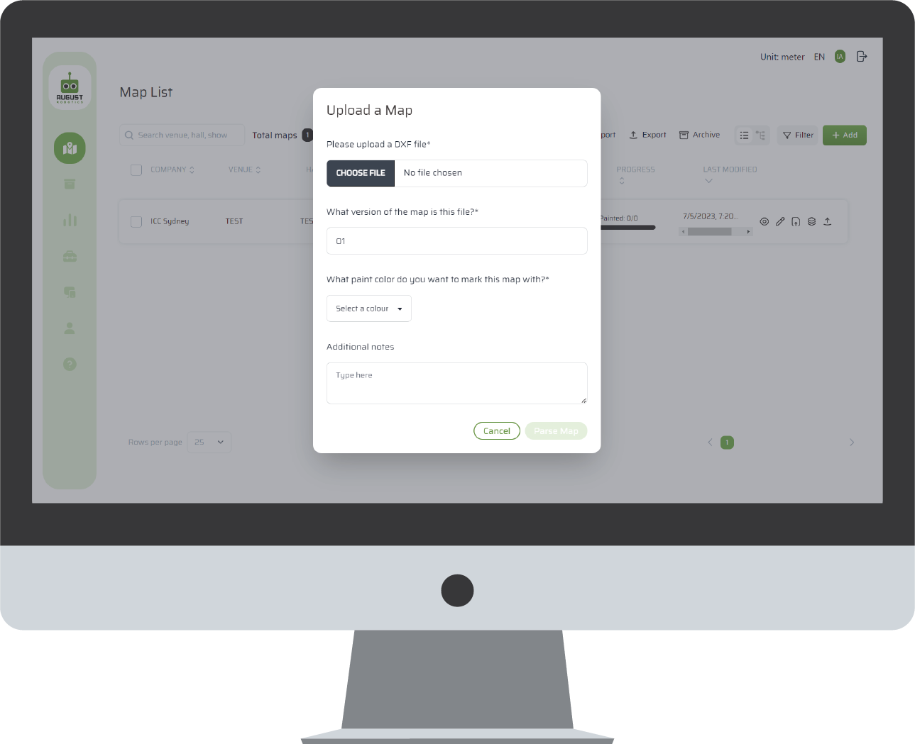

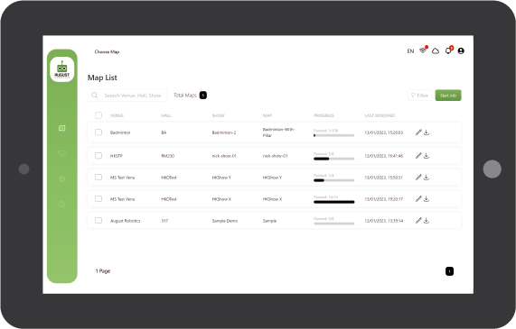
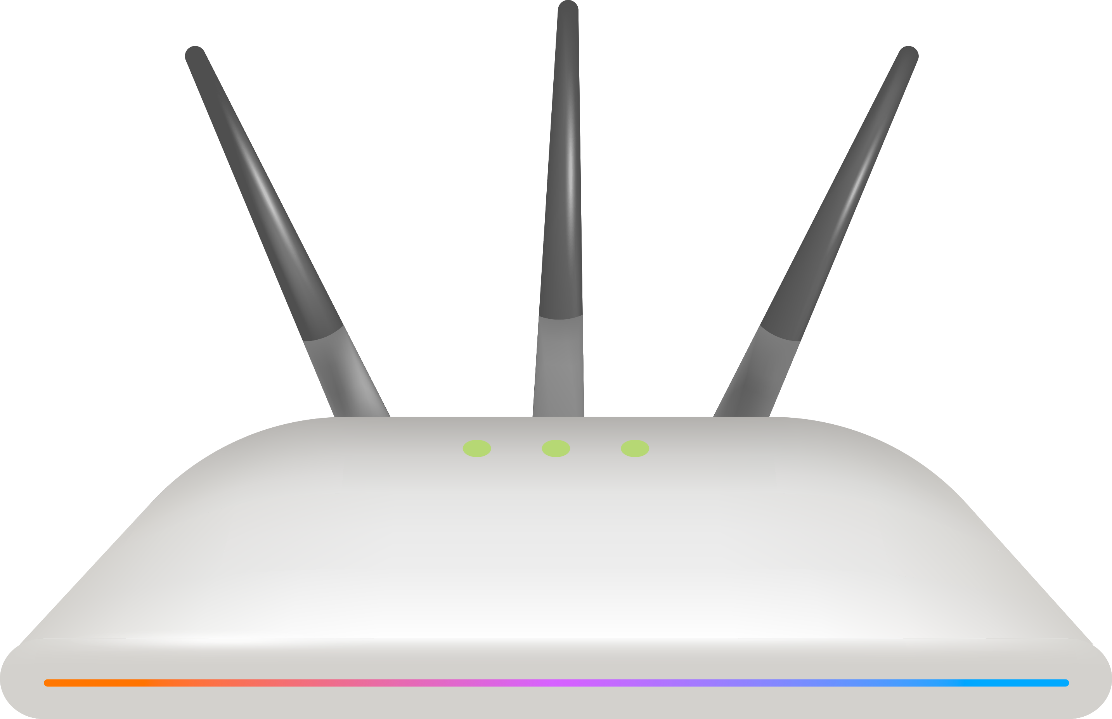

How does this all work together?
Updated since Jan 2022
MODULE 2: MAP UPLOAD
Requires access to internet (office Wi-Fi, Hall Wi-Fi or Mi-Fi)
Does not require internet
2
portal.augustrobotics.com
3
Lionel system operates independently
On the tablet, operator downloads map from the portal onto the Map Server
、
1
In the office, CAD team/ Technical Manager upload and parse the CAD file
The Map Server has its own local network This connects the Map Server to the tablet and devices
When you parse, you label the layers for Lionel’s software
Office Wi-Fi, Hall Wi-Fi or Mi-Fi
Local Wi-Fi
Optional: If you want to monitor the job remotely, keep the Map Server connected to the internet

Slide 32
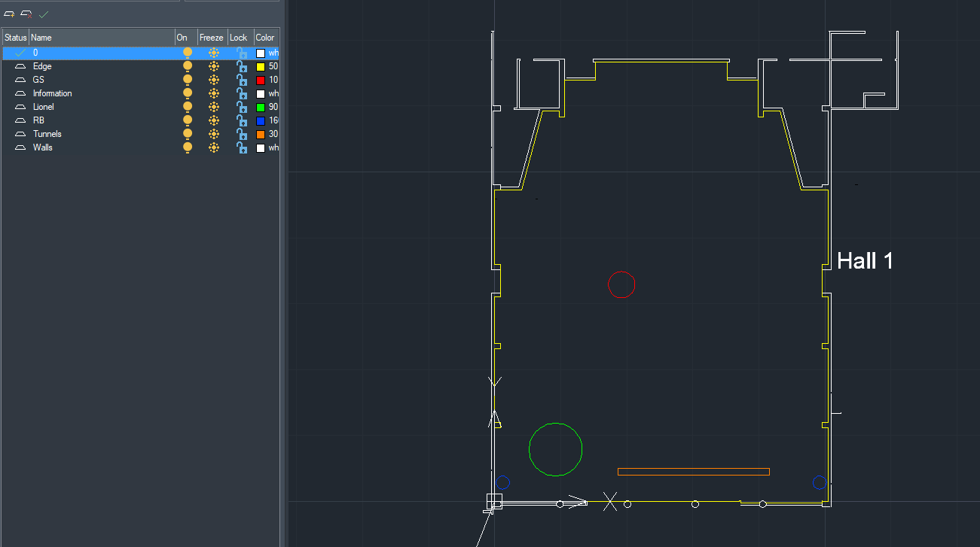
A CAD template will provided for each of your halls
MODULE 2: MAP UPLOAD
We will create a CAD template for each of your halls for the client portal map processing
After copying the corners, text and symbols from your CAD into the template we have created, you can begin processing the map

Slide 33
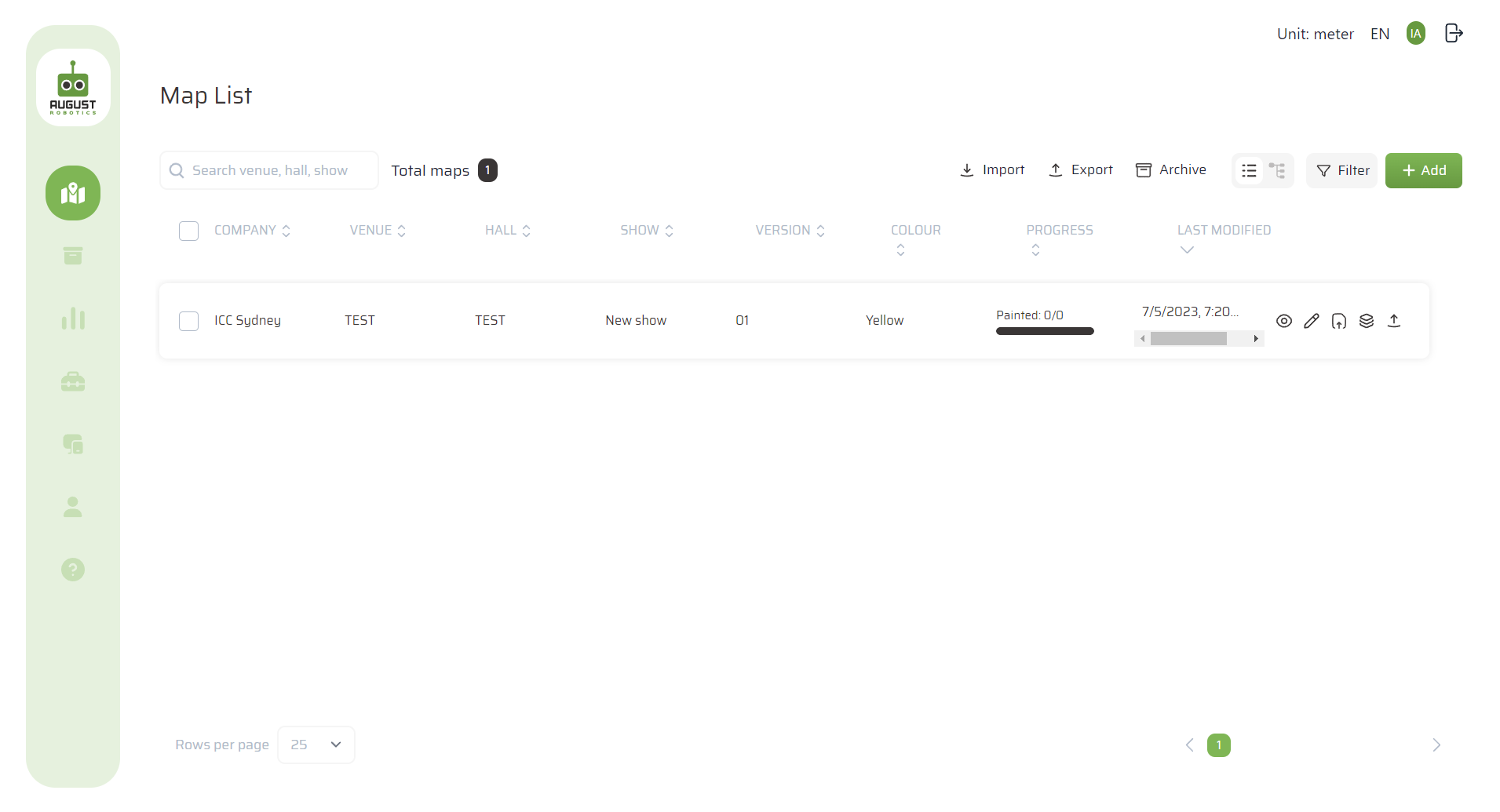
First, log into the User Portal
New page March 2024
Module 2: map upload
The User Portal provides a quick and simple way to convert your existing CAD files into instructions for Lionel
Go to https://portal.augustrobotics.com
Log in using the username and password that August Robotics provided you
Change your password after the first login by clicking the button with your initials on the top-right

Slide 34
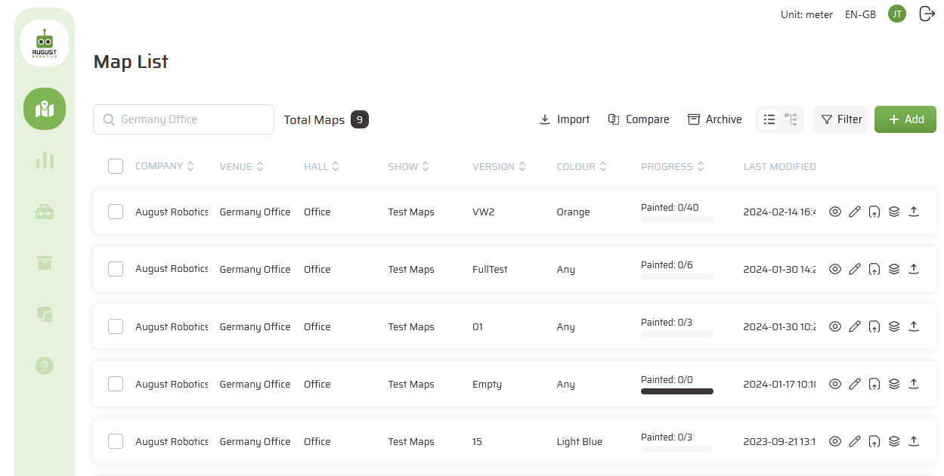
You can navigate the User Portal using the buttons on the left
New page 2024
Module 2: map upload
User Profile
Current Maps
Reports
Equipment
Archived Maps
Remote Monitoring
Help

Slide 35
To upload a new map, begin by clicking “Add”
New page 2024
Module 2: map upload

Slide 36
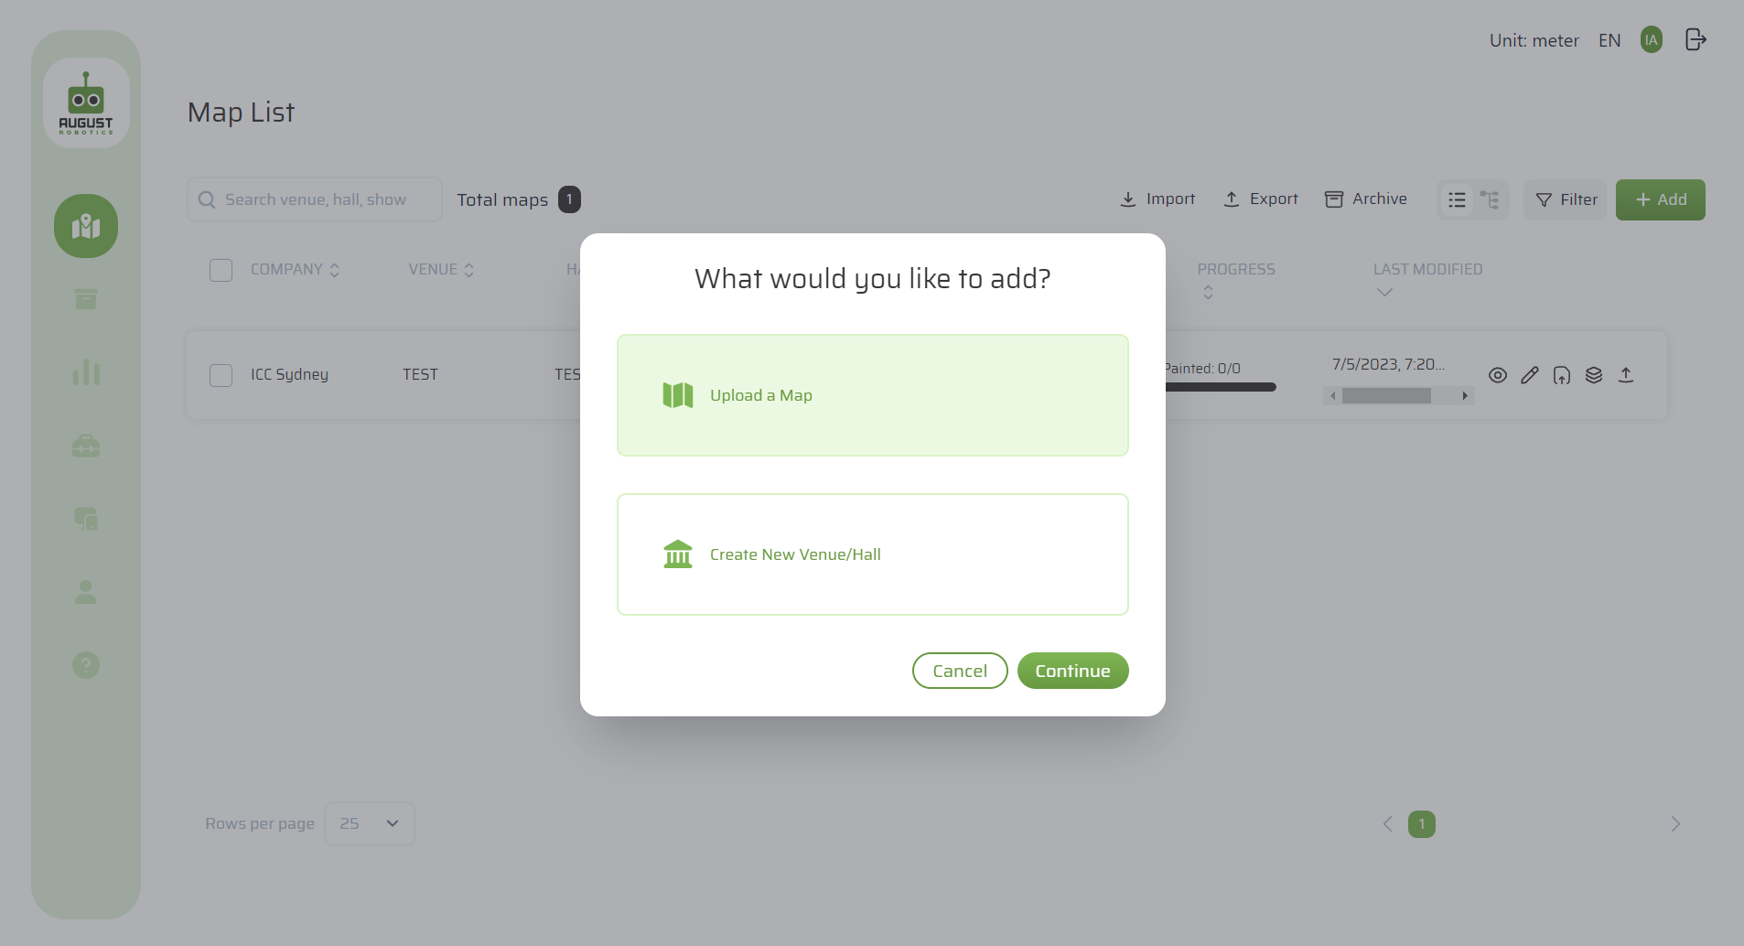
Select “Upload a Map”
New page March 2024
Module 2: map upload
From here, you can either:
Upload a map, or
Create a new venue / hall. This only needs to be done once per hall

Slide 37
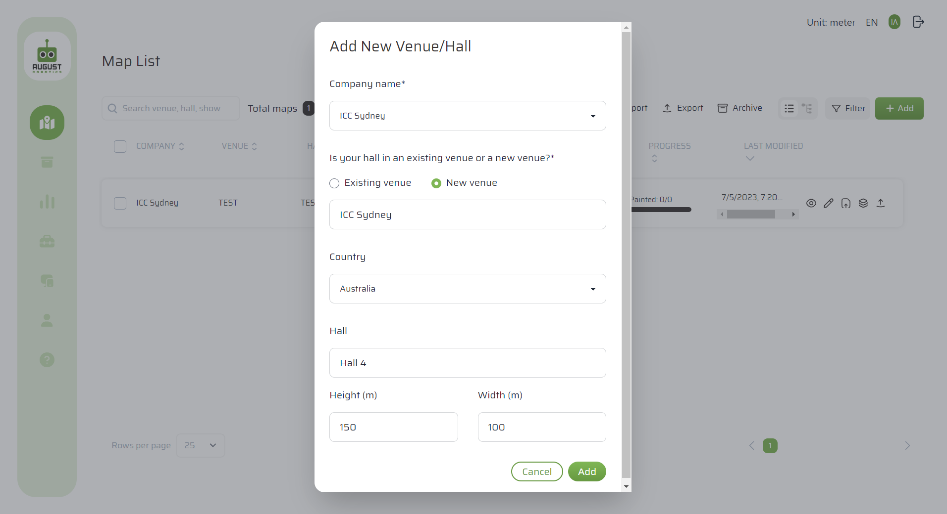
[Optional] If the hall is not in the system, you need to add a new venue / hall…
New page March 2024
MODULE 2: MAP UPLOAD
If you are a floor marking contractor that works across different venues, you may need to add a “New venue” before adding a new hall
If you are a venue, simply select “Existing venue”, select your venue and then add a new hall
Remember: This step is only relevant if the hall is not yet in the system

Slide 38
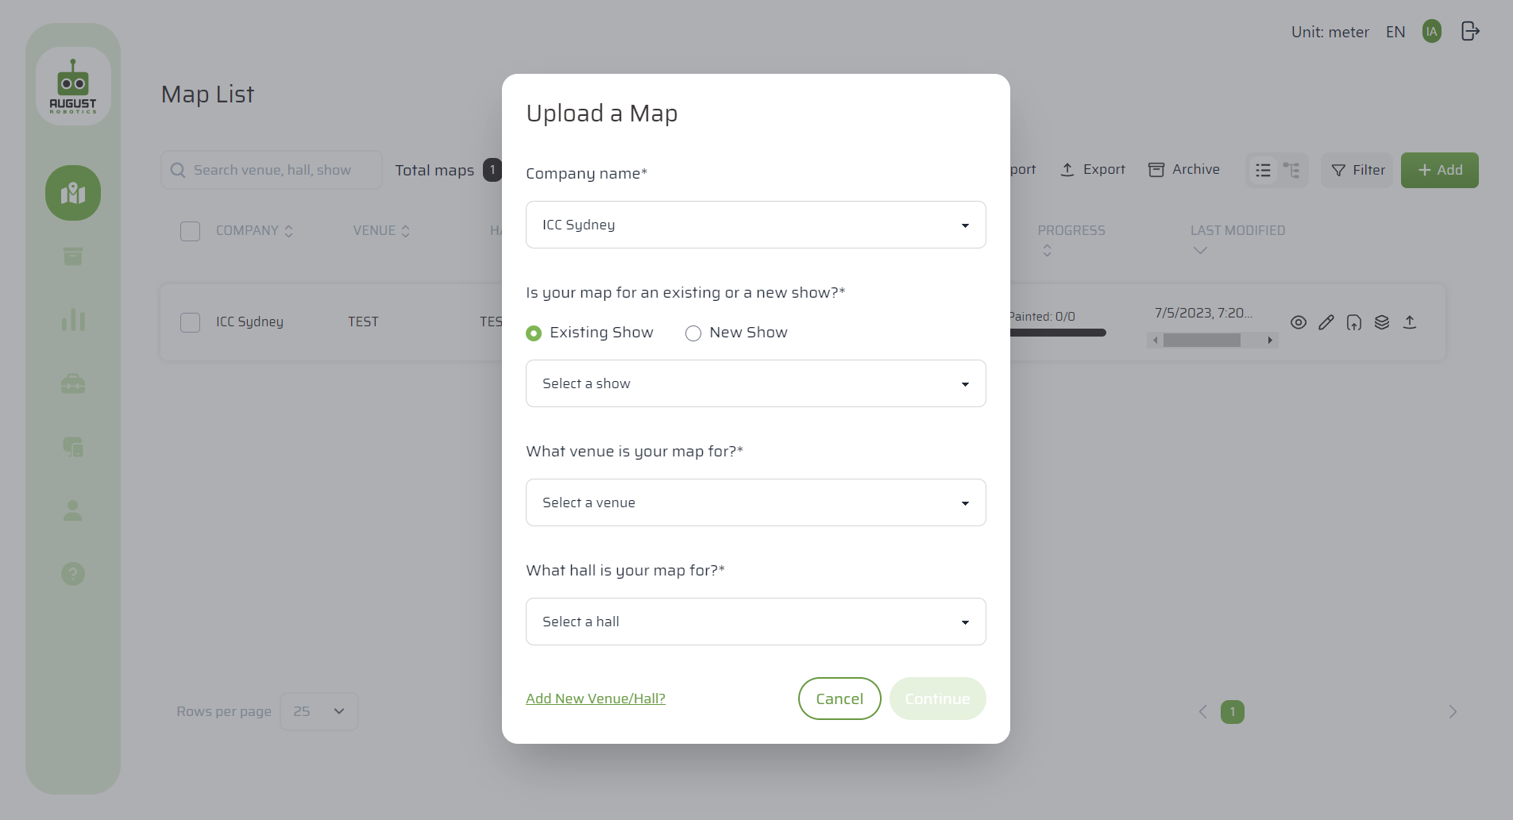
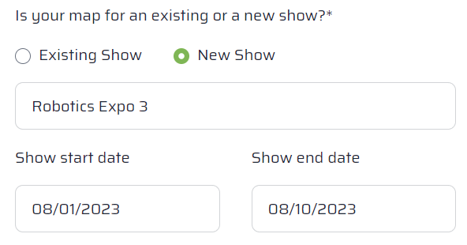
Start off by specifying the name of the show
New page
Module 2: map upload
Select the show the map is for. If the show is not in the system, input the show details
Select the venue
Select the hall

Slide 39
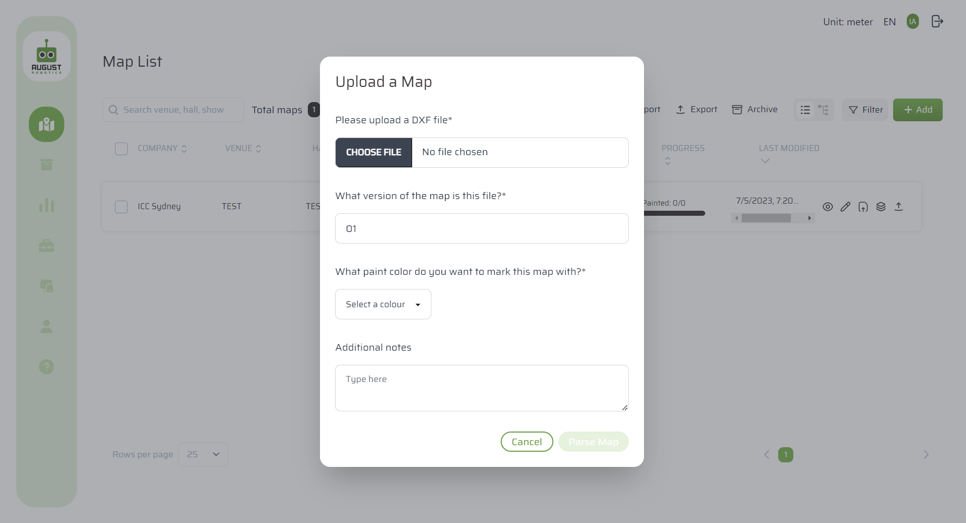
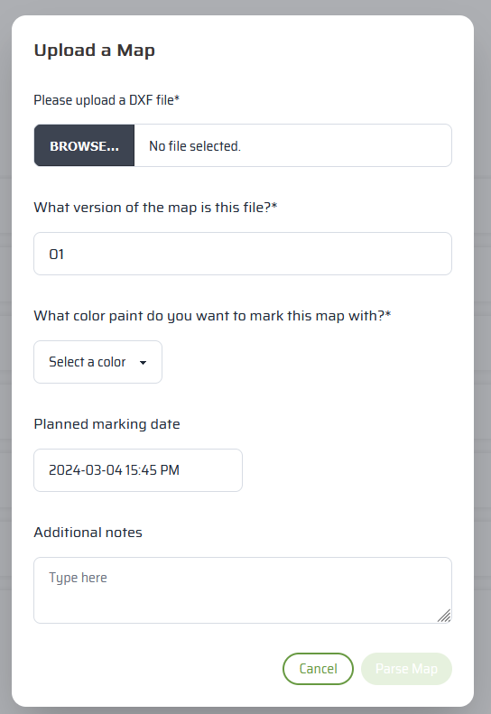
Upload your map
New page
Module 2: map upload
Upload your map as a DXF file. DXF 2007 is recommended.
Enter the version number.
If this is the first version of the map for that show, enter “01”
If you later upload an updated file, enter “02” and so on
The portal will not accept two maps with the same version number
Select a paint colour you plan to use to mark the show
Click “Parse Map”
You have the option to provide your planned marking date
Providing this date allows us to allocate support resources effectively

Slide 40
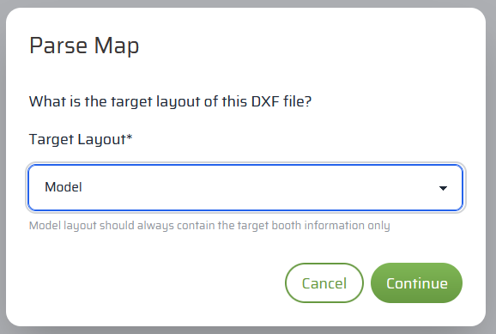
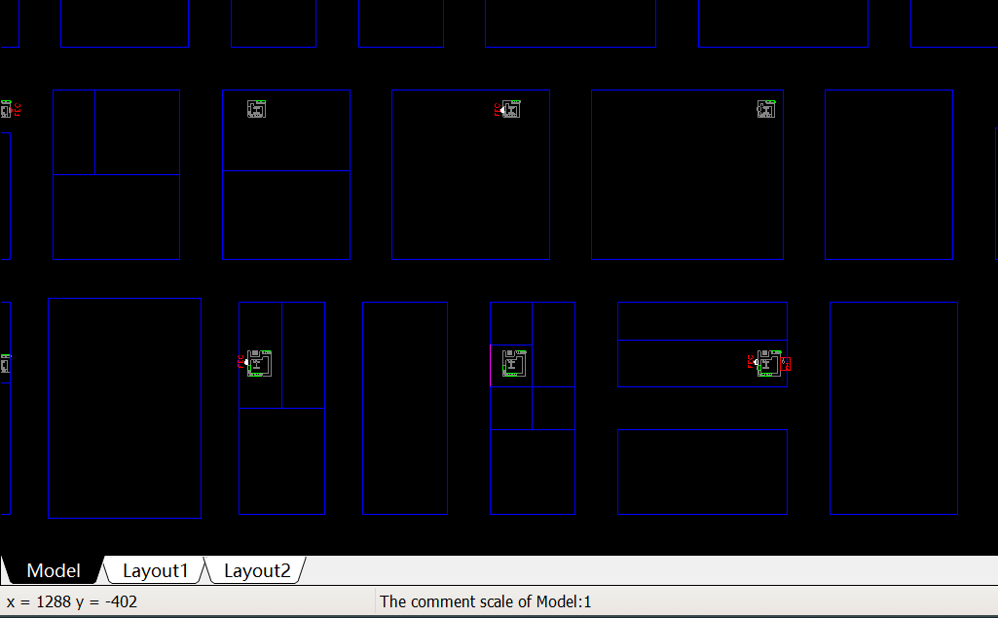
Confirm the target layout is named ‘Model’
Module 2: map upload
First, we need to confirm which layout (drawing/ view) you want to work on
The default name for this Target Layout is ‘Model’
In most CAD plans, the default name is ‘Model’, but some files may use a different name. Please confirm your active layout is called ‘Model’ before proceeding
If it is not already named ‘Model’, simply right-click on the tab and rename it to ‘Model’. You should already be familiar with how to rename layouts in your CAD software
Target Layout is always “Model”
See this example from a typical CAD

Slide 41
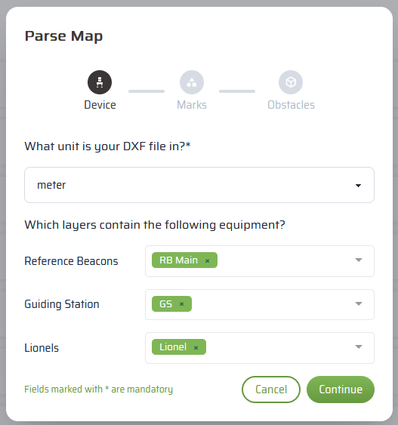
Identify the layers related to Devices
New page
Module 2: map upload
In order to convert a CAD file into instructions for the robots, we need to parse the map i.e. allow Lionel to identify the different layers
The first set of layers provide the default positions for all your devices in the hall
The CAD template provided by August Robotics will already have these layers included for you
In the screenshot, we have shown the default layers from CAD template
These layers contain the locations of all the equipment in the hall, so that the Lionel robots and Guiding Stations can locate each other
While specifying these layers is optional, it is highly recommended

Slide 42
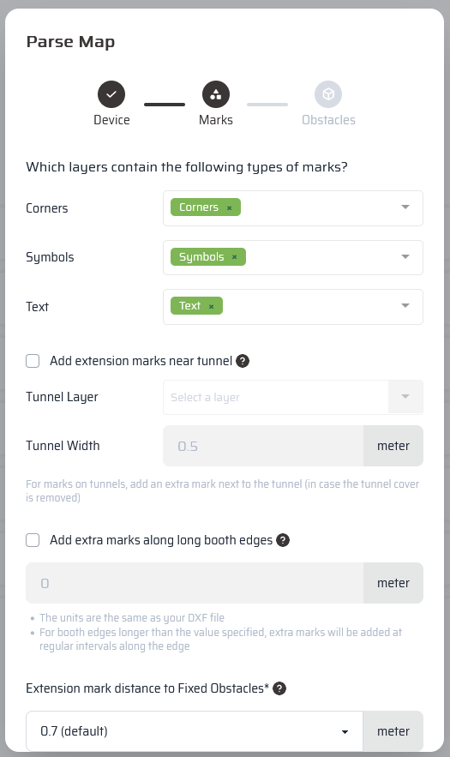
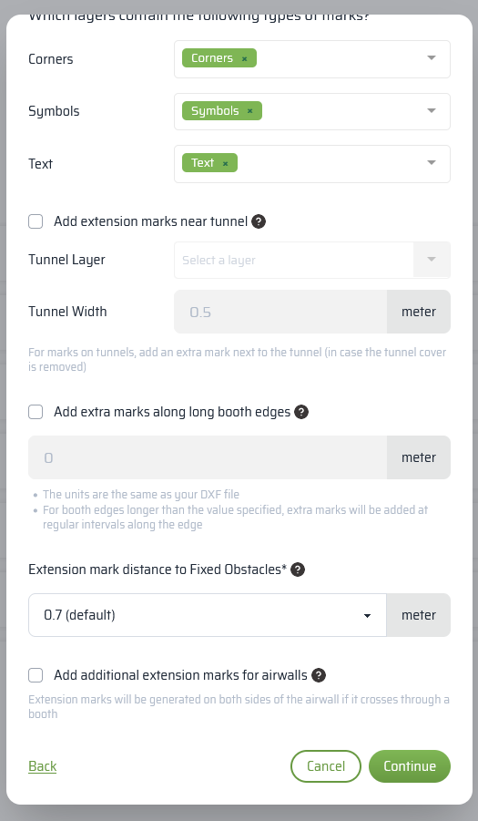
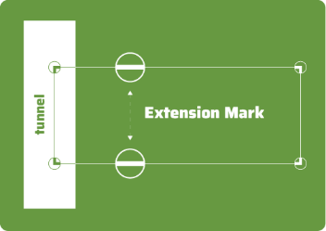
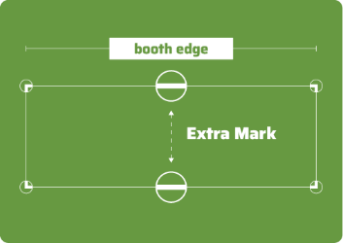


Next, identify the layers related to the marks
New page
Module 2: map upload
Identify what needs to be marked…
… you also have the option to generate additional marks depending on the job needs
Where a mark is made on a tunnel cover, an extra mark can be made next to the tunnel (in case the tunnel cover is moved)
If you want extra marks in the for long booth edges, tick this box
If a mark is too close to an obstacle, an ‘Extension Mark’ is generated. The distance from the obstacle can be changed
IMPORTANT: These layers must contain all the information that needs to be marked. If it is not here, it will not be marked
If an airwall crosses through a booth, an additional mark on either side of the airwall can be added

Slide 43

Identify the layers related to obstacles and hall features
New page
Module 2: map upload
The last set of layers provide information on the physical features of the hall
The CAD template provided by August Robotics will already have default layers included for you
In the screenshot, we have shown the default layers from CAD template
The obstacle layer will contain all the permanent obstacles in the hall (e.g. walls and pillars)
The information layer can contain any other details that may be useful to orient yourself in the hall (e.g. electrical tunnels)

Slide 44







Parse the map
New page
Module 2: map upload
After the map has been parsed
Click the “View” or “Edit” icons to review
If you need to add or revise anything, you can
Edit the map you just parsed (usually used for small changes), or
Upload a new DXF file (usually used if booth layouts have changed), or
Re-parse the current DXF file (usually used if you made a mistake in selecting layers)
Press F5 to refresh the page
Once the map has finished parsing, the number of marks to be painted will be displayed
It is important to review the map once parsed. See tips on inspecting the map in Module 3

Slide 45
Module 3: On-Site Preparation
Lionel Training Course
Last updated March 2024 | Go to the User Portal to download the latest version
Confidential – do not distribute

Slide 46
Where are we?
Updated since Jan 2022
MODULE 3: ON-SITE PREPARATION
In the office
On-site
Module 1
Module 2
Module 3
Overview
Introducing the components of the Lionel system – Robot, Guiding Station, Reference Beacon, Map Server – and how they work together
Map Upload
Walking through how to use the User Portal to upload, process and edit your maps
On-Site Preparation
Demonstrating steps to take on-site before the job: charging batteries, opening the Map Server Box, syncing the latest map and preparing the paint
Module 4
Module 5
Module 6
Module 7
Equipment Set-Up
Demonstrating how to set up and calibrate the equipment on-site (the Reference Beacons, Guiding Station and Lionel Robot)
Job Supervision
Demonstrating how to use the Map Server to monitor Lionel as it marks your floors
Clean Up
Demonstrating the steps you need to take after Lionel completes a job to care for the equipment
Proactive Care & Troubleshooting
Demonstrating the proactive maintenance processes you need to perform and the common reactive troubleshooting methods

Slide 47

What is in Module 3, On-Site Preparation?
Updated since Jan 2022
MODULE 3: ON-SITE PREPARATION
The day before...
Charge all batteries
Use the charging station to charge all the batteries

Slide 48

What is in Module 3, On-Site Preparation?
Updated since Jan 2022
MODULE 3: ON-SITE PREPARATION
The day before...
Charge all batteries
Use the charging station to charge all the batteries

Slide 49








Before the day of the job, you will need to charge your batteries
Updated March 2024
MODULE 3: ON-SITE PREPARATION
The number of batteries you have depends on the number of equipment you have
One Lionel robot
Requires one 24V battery
One Guiding Station
Requires one 24V battery OR the External Power Supply connected to a power socket
One pair of Reference Beacons
Requires two 12V batteries
One Map Server
Requires one 24V battery OR 110V/220V power supply from a power socket

Slide 50

The charging station
Updated March 2024
MODULE 3: ON-SITE PREPARATION
Charge your large 24V batteries in the large slots (there are 6 slots)
IN port
Charge your small 12V batteries in the small slots (there are 2 slots)
Make sure to plug the charging cable into the “IN” port
Charge the Tablet separately or use the USB port in the Map Server box to charge the Tablet
IN port

Slide 51


Use the charging station to charge all your batteries at once
MODULE 3: ON-SITE PREPARATION
Charge your large 24V batteries in the large slots (there are 6 slots)
Charge your small 12V batteries in the small slots (there are 2 slots)
Either charge the Tablet separately or use the USB port in the Map Server box to charge the Tablet
CLICK TO PLAY VIDEO

Slide 52

What is in Module 3, On-Site Preparation?
Updated since Jan 2022
Updated again March 2024
MODULE 3: ON-SITE PREPARATION
The day before...
On the day...
Power on the Map Server
Charge all batteries
Use the charging station to charge all the batteries
Power on the Map Server and retrieve the Tablet
You must have internet

Slide 53
How does this all work together?
Updated since Jan 2022
MODULE 2: MAP UPLOAD
Requires access to internet (office Wi-Fi, Hall Wi-Fi or Mi-Fi)
Does not require internet
2
portal.augustrobotics.com
3
Lionel system operates independently
On the tablet, operator downloads map from the portal onto the Map Server
、
1
In the office, CAD team/ Technical Manager upload and parse the CAD file
The Map Server has its own local network This connects the Map Server to the tablet and devices
When you parse, you label the layers for Lionel’s software
Office Wi-Fi, Hall Wi-Fi or Mi-Fi
Local Wi-Fi
Optional: If you want to monitor the job remotely, keep the Map Server connected to the internet

Slide 54
On the day of the job, turn on the Map Server
MODULE 3: ON-SITE PREPARATION
Tablet with Map Server Interface
that on-site operators use to access the Map Server Interface
Power switch
to turn on the Map Server box
Map Server
the “brain” that controls the equipment in the system
Accessory Bag
with seven cords and accessories
Mesh Routers
that are connected to the robot and Guiding Station to establish communication within the system

Slide 55


Turn on the Tablet and open Settings to connect to the Map Server Wi-Fi
Added March 2024
MODULE 3: ON-SITE PREPARATION
Click the Settings icon

Slide 56


Connect Tablet to Map Server (MSP1-00xx) Wi-Fi
Added March 2024
MODULE 3: ON-SITE PREPARATION
Mark sure you’re connected to MSP1-00xx
The Password for the network MSP1-00xx is ‘augustbase’
Network: MSP1-00XX
Password: augustbase

Slide 57


Open the Map Server Interface
Added March 2024
MODULE 3: ON-SITE PREPARATION
You can open the Map Server Interface in two ways:
Click on the shortcut with the August Robotics logo
Open Firefox and enter the IP address: 192.168.59.99
A
B
B

Slide 58
Log into the Map Server Interface
Added March 2024
MODULE 3: ON-SITE PREPARATION
Log in by entering the Username ‘operator’ and Password ‘aug’
Username: operator
Password: aug

Slide 59




Connect the Map Server (MSP) to the internet
Added March 2024
MODULE 3: ON-SITE PREPARATION
Click on the Wi-Fi symbol
Select your Wi-Fi Network
Input the password
You can connect the MSP to your hall/office Wi-Fi, or phone hotspot

Slide 60



What is in Module 3, On-Site Preparation?
Updated since Jan 2022
MODULE 3: ON-SITE PREPARATION
The day before...
On the day...
On the day...
[Optional] Pull the latest map and/or make last minute edits
Power on the Map Server
Charge all batteries
Use the charging station to charge all the batteries
Power on the Map Server box and retrieve the Tablet
You must have internet
Use the Tablet to access your maps
Ideally, you will have pulled / downloaded your maps to the Map Server before the job day

Slide 61
If you already have the map on the Map Server, you do not need to download/pull maps again

Slide 62

Pull maps from your User Portal to the Map Server
MODULE 3: ON-SITE PREPARATION
Click ‘Pull map’ to transfer map(s) from your User Portal to your Map Server
[Optional] Later, if you have edited your map(s) on the Map Server (e.g. to add a new moveable obstacle), you can also click ‘Push map’ to transfer the updated map(s) back to your User Portal

Slide 63


Pull maps from your User Portal to the Map Server
Added March 2024
MODULE 3: ON-SITE PREPARATION
Select your maps on the left side and click Pull Now to download them
If you see a red yes under “conflict”, be careful.
This means the map that is currently on your MSP will be replaced with the one currently on the portal
You WILL lose current mark status, flagged marks and any data stored on the map

Slide 64

Select a map to view / inspect
Updated March 2024
MODULE 3: ON-SITE PREPARATION
The list of maps you have pulled from the User Portal to the Map Server will be shown here
Click on the eye icon to view and the pencil icon to edit a map on the Map Server
Try not to edit maps on the Map Server unless necessary. It is easier to edit maps in the User Portal before the job day

Slide 65






Inspect the map: Navigation
Updated March 2024
MODULE 3: ON-SITE PREPARATION
Pinch the screen to zoom in on different sections of the map
There are 4 buttons on the bottom right of the map
Zoom in/out and move around the map
Drag or click to select marks and obstacles
Click to see coordinates on the map
Click to reset the map view

Slide 66

Inspect the map: Legend
Updated March 2024
MODULE 3: ON-SITE PREPARATION
The multicolored button on the left opens a pop-up window to view/hide and/or highlight specific type of marks and information
Clicking Flagged Marks highlights marks which may not be perfectly painted on the floor
Clicking Unpainted Marks highlights marks which still need to be painted
Clicking Unreachable Marks highlights marks the system may not be able to reach

Slide 67
Inspect the map: Overview
Updated March 2024
MODULE 3: ON-SITE PREPARATION
The marks and obstacles for this map are displayed here
The bottom left panel is the map overview
‘Enabled’ marks are marks that the user has requested Lionel to paint. They may be
‘Painted’ (Lionel has physically painted the mark)
‘Unpainted’ (Lionel has not yet painted the mark)
‘Disabled’ marks are marks that the user has requested Lionel to not paint. They may be
Painted (rare)
Unpainted
‘Enabled’ and ‘Disabled’ describe the user’s choice. ‘Painted’ and ‘Unpainted’ describe Lionel’s progress
Total marks = Enabled marks + Disabled marks

Slide 68


What is in Module 3, On-Site Preparation?
Updated since Jan 2022
Updated March 2024
MODULE 3: ON-SITE PREPARATION
The day before...
On the day...
On the day...
On the day...
[Optional] Pull the latest map and/or make last minute edits
Power on the Map Server
Charge all batteries
Add the paint
Use the charging station to charge all the batteries
Power on the Map Server box and retrieve the Tablet
You must have internet
Use the Tablet to access your maps
Ideally, you will have pulled / downloaded your maps to the Map Server before the job day
Choose the correct paint colour for the show and install the bottle into the robot

Slide 69

Prepare the paint
New page
MODULE 3: ON-SITE PREPARATION
August Robotics offers a range of washable paint colours:
White
Yellow
Blue
Green
Red
Pink
Orange
Purple
Before using, shake the paint bottle WELL to make sure the mixture is even and has no sediment – bad paint leads to bad marks
Contact August Robotics if you wish to order more paint

Slide 70
Module 4: Equipment Set-Up
Lionel Training Course
Last updated March 2024| Go to the User Portal to download the latest version
Confidential – do not distribute

Slide 71
Where are we?
Updated since Jan 2022
MODULE 4: EQUIPMENT SET-UP
In the office
On-site
Module 1
Module 2
Module 3
Overview
Introducing the components of the Lionel system – Robot, Guiding Station, Reference Beacon, Map Server – and how they work together
Map Upload
Walking through how to use the User Portal to upload, process and edit your maps
On-Site Preparation
Demonstrating steps to take on-site before the job: charging batteries, opening the Map Server Box, syncing the latest map and preparing the paint
Module 4
Module 5
Module 6
Module 7
Equipment Set-Up
Demonstrating how to set up and calibrate the equipment on-site (the Reference Beacons, Guiding Station and Lionel Robot)
Job Supervision
Demonstrating how to use the Map Server to monitor Lionel as it marks your floors
Clean Up
Demonstrating the steps you need to take after Lionel completes a job to care for the equipment
Proactive Care & Troubleshooting
Demonstrating the proactive maintenance processes you need to perform and the common reactive troubleshooting methods

Slide 72
Simple steps to start running:
MODULE 4: EQUIPMENT SET-UP
1
Turn on Map Server
Turn on Tablet and connect Tablet to Map Server Wi-Fi
Open the Map Server Interface
Connect Map Server to the internet
Inspect map/s
Follow setup checklist
Calibrate Guiding Station/s and Lionel/s
Start map
Start Lionels
2
3
4
5
6
7
8
9

Slide 73
Open the Map Server Box, flip the power switch
MODULE 4: equipment set-up
Power switch
to turn on the Map Server box
Map Server
the “brain” that controls the equipment in the system

Slide 74
Turn on the Tablet and open Settings to connect to the Map Server Wi-Fi
Added March 2024
MODULE 4: equipment set-up
Click the Settings icon

Slide 75
Connect Tablet to Map Server (MSP1-00xx) Wi-Fi
Added March 2024
MODULE 4: equipment set-up
Mark sure you’re connected to MSP1-00xx
The Password for the network MSP1-00xx is ‘augustbase’
Network: MSP1-00XX
Password: augustbase

Slide 76
Open the Map Server Interface
Added March 2024
MODULE 4: equipment set-up
You can open the Map Server Interface in two ways:
Click on the shortcut with the August Robotics logo
Open Firefox and enter the IP address: 192.168.59.99
A
B
B

Slide 77
Log into the Map Server Interface
Added March 2024
MODULE 4: equipment set-up
Log in by entering the Username ‘operator’ and Password ‘aug’
Username: operator
Password: aug

Slide 78
Connect the Map Server (MSP) to the internet
Added March 2024
MODULE 4: equipment set-up
Click on the Wi-Fi symbol
Select your Wi-Fi Network
Input the password
You can connect the MSP to your hall/office Wi-Fi, or phone hotspot

Slide 79
If you have not pulled the map/s yet, please use the process in Module 3

Slide 80

Select the maps from your User Portal that you would like to mark
MODULE 4: EQUIPMENT SET-UP
You can mark multiple shows at the same time, simply select more than one map and click on “Start Job”
If you select multiple maps for a job, the maps must be for the same hall.

Slide 81

Preview job and click Confirm
MODULE 4: EQUIPMENT SET-UP
Here you can quickly inspect the map/s.
Check to see that all booths appear to be in the correct location and nothing seems abnormal
If acceptable, click confirm

Slide 82



Equipment Set-up
MODULE 4: EQUIPMENT SET-UP
Setting up the Reference Beacons
Setting up the Guiding Station
Calibrating the Guiding Station
Setting up Lionel
Calibrating Lionel

Slide 83
Recap of how the system works
MODULE 4: EQUIPMENT SET-UP
Refer to Module 1 for a recap of why we need all these components
Guiding Station
In summary,
The predefined Reference Points tell you where to place the Reference Beacons
The Reference Beacons enable the Guiding Station (once calibrated) to understand its position
The Guiding Station enables the Lionel robot (once calibrated) to understand its position
Lionel Robot
Reference Beacon
Reference Beacon
Reference Point
Reference Point

Slide 84

The Map Server Interface will guide you through the setup process step-by-step
MODULE 4: EQUIPMENT SET-UP
Do we have all our equipment on site?

Slide 85
Equipment Set-Up
MODULE 4: EQUIPMENT SET-UP
Setting up the Reference Beacons
Setting up the Guiding Station
Calibrating the Guiding Station
Setting up Lionel
Calibrating Lionel

Slide 86

Place the two Reference Beacons on the Reference Points in the hall
MODULE 4: EQUIPMENT SET-UP
Your August Robotics representative will have pre-defined two Reference Points for the physical hall
The Reference Points allow us to “match” the digital plan with the physical hall
These points will have been physically marked in the hall by August Robotics (e.g. with a nail on the ground)
Place the two Reference Beacon stands over the two Reference Points
Reference Point
Reference Point

Slide 87

Place the two Reference Beacons on the Reference Points in the hall
MODULE 4: EQUIPMENT SET-UP
Your August Robotics representative will have pre-defined two Reference Points for the physical hall
The Reference Points allow us to “match” the digital plan with the physical hall
These points will have been physically marked in the hall by August Robotics (e.g. with a nail on the ground)
Place the two Reference Beacon stands over the two Reference Points
Levelling bubble
Levelling screws
Reference Beacon stand
Laser light (red dot) directly on top of reference point (black cross)

Slide 88
Adjust the Reference Beacons and power them on
MODULE 4: EQUIPMENT SET-UP
For each Reference Beacon stand:
Turn on the laser using the red switch
Adjust the position of the stand so the downward laser shines precisely onto the reference point (see photo on previous page)
Level the Reference Beacon by using the black levelling screws to centre the round bubble
Mount the blue and green beacon onto the stand
Check the position of the laser. This may have moved during the above steps. Adjust the position of the stand again so the laser shines precisely onto the reference point
Repeat the above two steps until the bubble and the laser are both in the correct place
Connect a small 12V battery to the Reference Beacon. Take care not to move the Reference Beacon
Turn off the laser using the red switch
The following video demonstrates these steps

Slide 89

Adjust the Reference Beacons and power them on
If we hide this, we won’t have it in the pdf
MODULE 4: EQUIPMENT SET-UP
This video demonstrates the steps on the previous page
CLICK TO PLAY VIDEO

Slide 90

The Map Server recaps the above steps
MODULE 4: EQUIPMENT SET-UP

Slide 91
Module 4, Equipment Set-Up
MODULE 4: EQUIPMENT SET-UP
Setting up the Reference Beacons
Setting up the Guiding Station
Calibrating the Guiding Station
Setting up Lionel
Calibrating Lionel

Slide 92

Place the Guiding Station in its Suggested Home Base in the hall
MODULE 4: EQUIPMENT SET-UP
Your August Robotics representative will provide a “Suggested Home Base” for the Guiding Station, a rough area in which you should place the Guiding Station
From its Home Base, the Guiding Station will “look” for the Reference Beacon so the system can determine the Guiding Station’s precise position
The Home Base is highlighted digitally on the interface (in blue)
Place the Guiding Station in its Home Base in the hall
Guiding Station’s Suggested Home Base

Slide 93



Ensure the Guiding Station is placed in the correct orientation in the hall
Updated since Jan 2022
MODULE 4: EQUIPMENT SET-UP
Place the Guiding Station in the correct orientation. Match the X-Y sticker on the Guiding Station to X-Y direction on the map
Ensure that all four feet of the Guiding Station are in contact with the ground and that the Guiding Station is stable
Sticker on GS
Sticker on GS
Y
X

Slide 94
Add the components to the Guiding Station and power it on
MODULE 4: EQUIPMENT SET-UP
For the Guiding Station:
Connect a large 24V battery to the Guiding Station’s power cable
Place a Mesh Router into the holder on the side of the Guiding Station and attach the router power and LAN cable
Turn on the Guiding Station using the red switch. A red LED light indicates that the Guiding Station is powered on. Make sure the Emergency Stop button is not pressed
The following video demonstrates these steps

Slide 95


Add the components to the Guiding Station and power it on
MODULE 4: EQUIPMENT SET-UP
This video demonstrates the steps on the previous page
CLICK TO PLAY VIDEO

Slide 96

The Map Server recaps the above steps
MODULE 4: EQUIPMENT SET-UP

Slide 97
Module 4, Equipment Set-Up
MODULE 4: EQUIPMENT SET-UP
Setting up the Reference Beacons
Setting up the Guiding Station
Calibrating the Guiding Station
Setting up Lionel
Calibrating Lionel

Slide 98

Place the Lionel Robot in its Suggested Home Base in the hall
MODULE 4: EQUIPMENT SET-UP
Your August Robotics representative will provide a “Suggested Home Base” for the Lionel robot, a rough area in which you should place the robot as its starting position
The Home Base is the rough area the Guiding Station will “look” to find the Lionel robot so the system can determine Lionel’s position
The Home Base is highlighted digitally on the interface (in blue)
Place the physical robot in its Home Base in the hall
Lionel’s Suggested Home Base

Slide 99


Ensure the Lionel robot is placed in the correct orientation
Updated since Jan 2022
MODULE 4: EQUIPMENT SET-UP
Regardless whether you use the Suggested Home Base or the Customised Home Base...
Place the Lionel in the correct orientation, ensuring it matches the orientation the Lionel icon is facing in the Map Server Interface
View on Map server
Lionel in the hall

Slide 100
Add the battery and Mesh Router to Lionel
MODULE 4: EQUIPMENT SET-UP
For the Lionel robot:
Open the cover at the bottom of Lionel to reveal a black and red battery cable. Place a large 24V battery inside and connect it to the cable. Close the cover
Place a Mesh Router into the holder on the top of Lionel and attach the router power and LAN cable
The following video demonstrates these steps

Slide 101

Add the battery and Mesh Router to Lionel
MODULE 4: EQUIPMENT SET-UP
This video demonstrates the steps on the previous page
CLICK TO PLAY VIDEO

Slide 102
Load the paint into Lionel
MODULE 4: EQUIPMENT SET-UP
For the Lionel robot:
Take the Paint Tank containing prepared paint and place it into the compartment on the side of Lionel. Connect the tube on the Paint Tank to the pipe connector in Lionel’s compartment. Ensure the Paint Tank clicks into place. Take care not to damage the fittings.
Loosen the screw on the right side of Lionel’s nozzle. Add some water to the foam cap of the nozzle – this prevents the nozzle from drying out
Press the red switch between Lionel’s wheels to switch on Lionel. A red LED means Lionel is powered on.
Press the ‘Preload’ button to pump some paint from the Paint Tank to Lionel’s nozzle. Ensure that the tubes are not compressed. Hold the button until the paint flows out of the nozzle in a steady stream. This means the paint is properly loaded
The following video demonstrates these steps

Slide 103

Load the paint into Lionel
MODULE 4: EQUIPMENT SET-UP
This video demonstrates the steps on the previous page
CLICK TO PLAY VIDEO

Slide 104

The Map Server recaps the above steps
MODULE 4: EQUIPMENT SET-UP

Slide 105
What is next?
Module 4: equipment set-up
You are here
Setting up the Reference Beacons
Setting up the Guiding Station
Calibrating the Guiding Station
Setting up Lionel
Calibrating Lionel
So far in this module, you have
Placed the Reference Beacons on the Reference Points
Placed the Guiding Station in its Home Base
Placed the Lionel robot in its Home Base
However, only the Reference Beacons know precisely where they are in the hall
In the rest of the module, you will
Calibrate the Guiding Station – using the Reference Beacons, the Guiding Station will learn precisely where it is in the hall
Then, calibrate the Lionel robot – using the Guiding Station, the robot will learn precisely where it is in the hall, so it is ready to start

Slide 106
Module 4, Equipment Set-Up
MODULE 4: EQUIPMENT SET-UP
Setting up the Reference Beacons
Setting up the Guiding Station
Calibrating the Guiding Station
Setting up Lionel
Calibrating Lionel

Slide 107

Guiding Station states
Module 4: equipment set-up
The Guiding Station’s states are colour coded on the Map Server
Colour on Map Server Interface
State
Uninitialised
Unlocated
The Guiding Station will start at the ‘Uninitialised’ state
Blue
Locating
Idle / Running
After it has been successfully calibrated, the Guiding Station will be in ‘Idle’ state
Green
Red
Error

Slide 108


Guiding Station start ‘Uninitialised’ state
Module 4: equipment set-up
Uninitialised Guiding Station has not yet self-levelled
Initialised The self inclination test is done
Unlocated Guiding Station does not know its location, select the location on the map
Locating Guiding Station is finding its location in the hall
Idle Guiding Station is ready for the job
Error Try clicking the `Reset` button to repeat the calibration steps

Slide 109
Select a Guiding Station
Module 4: equipment set-up
Ensure that all four feet of the Guiding Station are in contact with the ground and that the Guiding Station is stable
Select the Guiding Station by clicking its box on the right panel

Slide 110
‘Initialise’ the Guiding Station
Module 4: equipment set-up
Click the ‘Initialise’ button

Slide 111


‘Initialise’ the Guiding Station
Module 4: equipment set-up
The initialisation process may take a few minutes – please wait

Slide 112

‘Locate’ the Guiding Station
Module 4: set-up equipment
The location of the Guiding Station icon should now mirror the location of the Guiding Station in the physical hall
Click on the Guiding Station icon – its blue bubble will expand to indicate it has been selected
Then, click the ‘Locate’ button
1
1
2
2

Slide 113


‘Locate’ the Guiding Station
Updated since Jan 2022
Module 4: set-up equipment
The Guiding Station will now ‘look’ for the Reference Beacons. This may take a few minutes

Slide 114

Guiding Station located successfully
Module 4: equipment set-up
Once located, the Guiding Station’s bubble turns green and the Guiding Station’s state becomes ‘Idle’
Click the ‘Lionel Calibration’ button to begin the Lionel calibration process
If there was an error in locating:
Double check that the physical equipment has been placed in the correct areas (Reference Beacons, Guiding Station)
Double check that the Guiding Station has been placed in the correct orientation

Slide 115
Module 4, Equipment Set-Up
MODULE 4: EQUIPMENT SET-UP
Setting up the Reference Beacons
Setting up the Guiding Station
Calibrating the Guiding Station
Setting up Lionel
Calibrating Lionel

Slide 116

To calibrate the Lionel robot, we need to use the Map Server Interface to progress it to an ‘Idle’ state
Module 4: equipment set-up
The Guiding Station’s states are colour coded on the Map Server
Colour on Map Server Interface
State
Lionel will start at the ‘Unlocated’ state
Blue
Unlocated
Locating
Idle / Running
After it has been successfully calibrated, Lionel will be in ‘Idle’ or ‘Running’ state
Green
Red
Error

Slide 117


‘Locate’ Lionel
Module 4: equipment set-up
Select the Lionel robot by clicking its box on the right panel

Slide 118




‘Locate’ Lionel
Module 4: equipment set-up
The location of the Lionel icon should now mirror the location of Lionel in the physical hall
Tap on the Lionel icon – its blue bubble will expand to indicate it has been selected
Click the ‘Ok’ button
If you are setting up multiple Lionel robots, repeat the above steps for the other robots
Then, click the ‘Locate’ button
1
2
1
2

Slide 119


‘Locate’ Lionel
Module 4: equipment set-up
The Guiding Station will now ‘look’ for the Lionel robot. This may take a few minutes
Once located, a symbol will appear. This shows the actual location, and correct orientation, of the Lionel robot
If there was an error in locating:
Double check that the physical equipment has been placed in the correct areas (Guiding Station, Lionel)
Double check that Lionel has been placed in the correct orientation

Slide 120

You have successfully calibrated Lionel
Module 4: equipment set-up
Once located, Lionel’s bubble turns green and Lionel’s state becomes ‘Idle’
This means you have completed the Lionel calibration process
Remove the Reference Beacons from the hall
Click ‘Ready to operate’

Slide 121



Start your map
Module 4: equipment set-up
We now need to select a map for each Lionel to run, first tap ‘Start Running’
Select the desired map, and tap ‘OK’
The Lionel state will then change to ‘Running’

Slide 122

Lionel will now start running the job
Module 4: equipment set-up

Slide 123
Module 5: Job Supervision
Lionel Training Course
Last updated March 2024 | Go to the User Portal to download the latest version
Confidential – do not distribute

Slide 124
Where are we?
Updated since Jan 2022
Module 5: job supervision
In the office
On-site
Module 1
Module 2
Module 3
Overview
Introducing the components of the Lionel system – Robot, Guiding Station, Reference Beacon, Map Server – and how they work together
Map Upload
Walking through how to use the User Portal to upload, process and edit your maps
On-Site Preparation
Demonstrating steps to take on-site before the job: charging batteries, opening the Map Server Box, syncing the latest map and preparing the paint
Module 4
Module 5
Module 6
Module 7
Equipment Set-Up
Demonstrating how to set up and calibrate the equipment on-site (the Reference Beacons, Guiding Station and Lionel Robot)
Job Supervision
Demonstrating how to use the Map Server to monitor Lionel as it marks your floors
Clean Up
Demonstrating the steps you need to take after Lionel completes a job to care for the equipment
Proactive Care & Troubleshooting
Demonstrating the proactive maintenance processes you need to perform and the common reactive troubleshooting methods

Slide 125


What is in Module 5, Job Supervision
Updated March 2024
Module 5: job supervision
After pressing ‘Run Job’, Lionel works independently
If all goes well, you do not need to do anything
This module shows you what to do if errors occur or if you have more advanced needs (e.g. need to add extra robots or Guiding Stations)
This module walks through the three features on the Map Server Interface that allow you to monitor / manage the job in real time
Equipment Status
View Flagged Mark
Priority Area Selection (covered in Advanced Operations)
Add Equipment

Slide 126

What does Lionel do when it is running the job?
Module 5: job supervision
Move, Stop, Adjust, Mark
The Lionel robot, even without the assistance of a Guiding Station, has a rough sense of its location. It will move towards the location of a mark and stop when it believes it is there
Then, Lionel will use a camera to find the Guiding Station. The Guiding Station uses a laser to determine Lionel’s precise position
If Lionel is slightly off of the correct position, Lionel will adjust itself
Lionel will then make the mark by spraying paint from its nozzle
Lionel will take the most efficient route to complete all the marks, guided by the Map Server
CLICK TO PLAY VIDEO

Slide 127



Lionel has a range of sensors
Module 5: job supervision
Lionel has multiple, independent sensors, resulting in a highly reliable obstacle avoidance and safety system
Level 1: Lidar
Level 2: Sonar
Level 3: Depth Camera
300 degree Lidar (Light detection and ranging) coverage, with 8 metre range
7 sonar sensors across the front and side of Lionel
Depth camera to detect some small and low obstacles on the floor
Diagrams are not to scale: range of sensors are larger

Slide 128


... meaning it can autonomously detect and plan around both static and dynamic obstacles
Module 5: job supervision
Lidar System:
E-stop area = 1 metre
Unexpected object within 1 metre will trigger E-Stop, with braking distance of 0.1 metres
Lidar detection range = 8 metres
Unexpected object within 8 metres will trigger Lionel to replan its path
Sonar and Depth Camera not shown on diagram

Slide 129


As a last line of defence, you can physically push the emergency stop button
Module 5: job supervision

Slide 130

Use the Map Server on the Tablet to supervise the Job
Updated March 2024
Module 5: job supervision
This shows the progress of the job
Use the plus icon to add new equipment
Use this pause button to stop a specific Lionel robot
Use this button to stop all the Lionel robots on the job

Slide 131


Equipment Status: check the status of the robot(s) and Guiding Station(s)
Updated March 2024
Module 5: job supervision
The Equipment Page on the right panel displays all the Lionel robots and Guiding Stations you have set up
Frequently check and ensure the Lionel robot(s) and Guiding Station(s) are in the correct states
Guiding Stations should be in ‘Idle’ or ‘Running’ states (green bubble on map)
Robot should be in ‘Running’ states (green bubble on map)

Slide 132

Equipment Status: if a piece of equipment is in an ‘Error’ state...
Updated March 2024
Module 5: job supervision
If a piece of equipment is in an ‘Error’ state
Click the ‘Refresh’ icon to view details and follow the instructions to fix the error
If the error persists, restart the piece of equipment by turning the power switch off and back on

Slide 133

Equipment Status: if Lionel needs new paint...
Updated since Jan 2022
Updated March 2024
Module 5: job supervision
If Lionel has run out of paint or requires a change in colour
Click the ‘Pause’ button to stop Lionel
Load the Paint Tank in Lionel’s compartment, repeating the steps in module 4
Confirm the show Lionel should mark with the paint
Click ‘Start Running’
You do not need to re-calibrate Lionel unless you have moved it (which usually will not happen as Lionel’s wheels will lock when it is paused)

Slide 134



Add Equipment: You can add extra Lionel robots and/or Guiding Stations to your job
Updated March 2024
Module 5: job supervision
One Lionel system consists of one robot and one Guiding Station
You can add additional Guiding Stations
You can add additional robots
This is required for halls that are large and halls with lots of pillars or other obstructions
Lionel always needs to establish line of sight to a Guiding Station to confirm and adjust its position before placing each mark
This enables you increase the speed of marking and complete the job faster

Slide 135


Add Equipment: Use this page to add extra Lionel robots and/or Guiding Stations to your job
Updated March 2024
Module 5: job supervision
Click to ‘Set Up’ extra robots or Guiding Stations
Repeat the calibration processes in module 4
Once you add extra Lionel robots, the Map Server will automatically divide the work between the robots in the most efficient manner

Slide 136

View Mark: You can use this feature to check the quality of your marks
Updated March 2024
Module 5: job supervision
Lionel has a camera to record each mark made and utilises AI to check each mark meets the quality standards
If the AI suspects a mark is bad quality, it will report a flagged mark
Using the View Mark feature, you can review the flagged marks
If the mark looks good, you can click Correct
If a mark is not to your liking, you can click Unpaint. If you unpaint the mark, the mark will be recorded as unpainted and reflected as such in the job report
Reminder: You will need to clean the mark and run the job again to paint a new mark

Slide 137





You can also monitor the job remotely on your laptop or your phone
Added March 2024
Module 5: job supervision
To monitor the job remotely
Ensure the Map Server is connected to the internet using the Hall Wi-Fi, Ethernet connection or a Mi-Fi
Log onto the User Portal and click on the ‘Remote Monitor’ icon

Slide 138

Remember: If you do not need to add extra equipment and encounter no errors, you do not need to do anything during the job
Module 5: job supervision

Slide 139
Module 6: Clean Up
Lionel Training Course
Last updated March 2024 | Go to the User Portal to download the latest version
Confidential – do not distribute

Slide 140
Where are we?
Updated since Jan 2022
Module 6: clean up
In the office
On-site
Module 1
Module 2
Module 3
Overview
Introducing the components of the Lionel system – Robot, Guiding Station, Reference Beacon, Map Server – and how they work together
Map Upload
Walking through how to use the User Portal to upload, process and edit your maps
On-Site Preparation
Demonstrating steps to take on-site before the job: charging batteries, opening the Map Server Box, syncing the latest map and preparing the paint
Module 4
Module 5
Module 6
Module 7
Equipment Set-Up
Demonstrating how to set up and calibrate the equipment on-site (the Reference Beacons, Guiding Station and Lionel Robot)
Job Supervision
Demonstrating how to use the Map Server to monitor Lionel as it marks your floors
Clean Up
Demonstrating the steps you need to take after Lionel completes a job to care for the equipment
Proactive Care & Troubleshooting
Demonstrating the proactive maintenance processes you need to perform and the common reactive troubleshooting methods

Slide 141


What is in Module 6, Clean Up?
Module 6: clean up
After the job...
Clean Up
After the job...
Pack Up
You need to clean
The paint tank and its pipe
Lionel’s spray nozzle
Lionel’s pipes
You need to replace
The spray nozzle’s foam cap
You will need the syringe, cleaning pipes and dredging needles
You need to pack up
Lionel
Guiding Station
Reference Beacons
Map Server
and recharge all the batteries
You can pack down the Reference Beacons as soon as all Guiding Stations have been calibrated

Slide 142

Clean: the paint tank and its pipe
Module 6: clean up
Release the paint tank from Lionel’s compartment by pushing the silver tab
Uncap the lid from the tank, taking care not to drip too much paint
Rinse the tank and the pipe with (ideally warm) water
Deep clean the empty tank:
Fill the tank with water. Place your hand over the lid to seal it then shake the tank. Drain out the water
Repeat this a few times
Deep clean the paint tank’s pipe:
Fill the cleaning syringe with water
Take the correct cleaning pipe and connect one end to the syringe and the other end to the paint tank’s pipe
Use the syringe to push water through the pipe. Repeat this a few times
Rinse the filter with water if there is still paint caught in it
CLICK TO PLAY VIDEO
Please note: Executing these steps after every job is a condition of warranty

Slide 143

Clean: the spray nozzle
Module 6: clean up
Fill the cleaning syringe with water
Attach the nozzle to the syringe and push water through the nozzle
Dredge the nozzle and rinse with water
CLICK TO PLAY VIDEO
Please note: Executing these steps after every job is a condition of warranty

Slide 144

Clean: Lionel’s pipes
Module 6: clean up
Take a clean paint tank, fill it with water and screw on its lid
Insert the tank into Lionel’s compartment and attach the pipe
Press and hold the ‘Preload’ button to allow the water to flush through Lionel’s pipes and out the nozzle. Gently press the pipe walls together to remove any remaining paint residue.
When you see a steady stream of clean water coming out of the nozzle, release the ‘Preload’ button
Release the paint tank from Lionel’s compartment by pushing the silver tab
Push the ‘Preload’ button again to drive air through Lionel’s pipes to push out the remaining water
CLICK TO PLAY VIDEO
Please note: Executing these steps after every job is a condition of warranty

Slide 145

Replace: the spray nozzle’s foam cap
Module 6: clean up
The foam cap exists to prevent Lionel’s spray nozzle from drying out. Replace the foam cap after every job
Loosen the screw on the right side of Lionel’s nozzle
Lift up the nozzle
Take out the old foam cap
Take the cylindrical puncher and a new piece of foam from the maintenance box
Press the puncher hard into the foam to carve out a round piece of foam
Place the new foam cap into the holder
Tighten the screw
CLICK TO PLAY VIDEO
Please note: Executing these steps after every job is a condition of warranty

Slide 146


After cleaning Lionel, pack up all the equipment and charge the batteries
Module 6: clean up
Lionel
Guiding Station
Reference Beacons
Map Server
Turn it off
Use a damp cloth to wipe down Lionel’s outer shell
Take out the battery and charge it
Once the battery is fully charged, cut off the power
Turn it off
Disconnect the battery and charge it
Once the battery is fully charged, cut off the power
Turn off their downward lasers once they are properly placed
Remove the Reference Beacons from the floor once the Guiding Station has been calibrated
Turn off the small battery. Disconnect it and charge it
Disassemble the beacons from their stand and put them back in the box
Turn it off
Place all cables and accessories back into the box
Disconnect the battery and charge it
Once the battery is fully charged, cut off the power
Please note: Executing these steps after every job is a condition of warranty

Slide 147
Module 7: Proactive Care & Troubleshooting
Lionel Training Course
Last updated March 2024 | Go to the User Portal to download the latest version
Confidential – do not distribute

Slide 148
Where are we?
Updated since Jan 2022
Module 7: PROACTIVE CARE and troubleshooting
In the office
On-site
Module 1
Module 2
Module 3
Overview
Introducing the components of the Lionel system – Robot, Guiding Station, Reference Beacon, Map Server – and how they work together
Map Upload
Walking through how to use the User Portal to upload, process and edit your maps
On-Site Preparation
Demonstrating steps to take on-site before the job: charging batteries, opening the Map Server Box, syncing the latest map and preparing the paint
Module 4
Module 5
Module 6
Module 7
Equipment Set-Up
Demonstrating how to set up and calibrate the equipment on-site (the Reference Beacons, Guiding Station and Lionel Robot)
Job Supervision
Demonstrating how to use the Map Server to monitor Lionel as it marks your floors
Clean Up
Demonstrating the steps you need to take after Lionel completes a job to care for the equipment
Proactive Care & Troubleshooting
Demonstrating the proactive maintenance processes you need to perform and the common reactive troubleshooting methods

Slide 149


There are four categories of care and troubleshooting
Module 7: proactive care and troubleshooting
Basic Troubleshooting
Advanced Troubleshooting
Category
Proactive Care
Proactive Service
Performed by
The User
August Robotics
The User
August Robotics
Steps the user needs to perform to care for the equipment after every job or every month
Advanced steps an August Robotics engineer will perform to care for the equipment after every 6,000 marks or every year
Basic steps the user can try if something is not working well
If, after trying basic troubleshooting, there are still issues, contact your August Robotics representative
Covered in this document?

Slide 150

There are four categories of care and troubleshooting
Module 7: proactive care and troubleshooting
Basic Troubleshooting
Advanced Troubleshooting
Category
Proactive Care
Proactive Service
Performed by
The User
August Robotics
The User
August Robotics
Steps the user needs to perform to care for the equipment after every job or every month
Advanced steps an August Robotics engineer will perform to care for the equipment after every 6,000 marks or every year
Basic steps the user can try if something is not working well
If, after trying basic troubleshooting, there are still issues, contact your August Robotics representative
Covered in this document?

Slide 151



Proactive Care for Lionel: General Check-Up
Module 7: proactive care and troubleshooting
Frequency:
Before and after every job
Before turning on Lionel, manually move the robot back and forth and side to side to check that no wheels are stuck
Ensure that all screws are tight, including the screws on the spray system, the screws on the wheels and the screws on the camera beacon
Ensure that the camera beacon can rotate freely without any abnormal resistance within its working range
Clean Lionel by wiping its outer shell
CLICK TO PLAY VIDEO
Please note: Executing these steps is a condition of warranty. You must do this in addition to all the steps in the ‘Clean Up’ module

Slide 152



Proactive Care for Lionel: Paint System
Module 7: proactive care and troubleshooting
Frequency:
Before and after every job
Check that the tube of the paint tank is not blocked
Check that the nozzle is not blocked by pressing the ‘Preload’ button and painting a test mark
If it is blocked, clean the spray nozzle – follow the instructions in Module 6.
Alternatively, change to a new nozzle (5 nozzles are provided per robot)
Replace the foam cap after every job – follow the instructions in Module 6
Wet the foam cap before every job
Please note: Executing these steps is a condition of warranty. You must do this in addition to all the steps in the ‘Clean Up’ module

Slide 153

Proactive Care for Lionel: Base
Module 7: proactive care and troubleshooting
Frequency:
Once a month
Ensure that each wheel is facing the correct angle – parallel to each other and to the body of the robot
Ensure that each wheel is screwed tightly to the base
Manually move the robot back and forth and side to side to check that no wheels are stuck
CLICK TO PLAY VIDEO
Please note: Executing these steps is a condition of warranty. You must do this in addition to all the steps in the ‘Clean Up’ module

Slide 154

Proactive Care for Guiding Station: General Check-Up
Module 7: proactive care and troubleshooting
Frequency:
Before and after every job
Ensure that none of the Guiding Station’s four feet are loose when lifting the Guiding Station, and that they are steady and firm when standing on the ground
Ensure the bolts on the Guiding Station’s levelling board are fixed tight
Ensure that the camera beacon can rotate freely without any abnormal resistance within its working range
CLICK TO PLAY VIDEO
Please note: Executing these steps is a condition of warranty. You must do this in addition to all the steps in the ‘Clean Up’ module

Slide 155

Proactive Care for Reference Beacons: General Check-Up
Module 7: proactive care and troubleshooting
Frequency:
Before and after every job
Ensure the downward pointing laser is working properly. Press the red button to turn it on and off.
If the laser is not working, replace the AAA battery
Ensure that none of the Reference Beacons’ feet are loose when lifting the Reference Beacon, and that they are steady and firm when standing on the ground
CLICK TO PLAY VIDEO
Please note: Executing these steps is a condition of warranty. You must do this in addition to all the steps in the ‘Clean Up’ module

Slide 156
Proactive Care for All Batteries
Module 7: proactive care and troubleshooting
Frequency:
Before and after every job
Before connecting any battery to any equipment, ensure there is no observable damage to the battery, including the outlet cable, connectors and the battery shell
Charge all batteries using the charging station the day before the job
Ensure that all batteries are charged and discharged / used once every two months
CLICK TO PLAY VIDEO
Please note: Executing these steps is a condition of warranty. You must do this in addition to all the steps in the ‘Clean Up’ module

Slide 157
There are four categories of care and troubleshooting
Module 7: proactive care and troubleshooting
Basic Troubleshooting
Advanced Troubleshooting
Category
Proactive Care
Proactive Service
Performed by
The User
August Robotics
The User
August Robotics
Steps the user needs to perform to care for the equipment after every job or every month
Advanced steps an August Robotics engineer will perform to care for the equipment after every 6,000 marks or every year
Basic steps the user can try if something is not working well
If, after trying basic troubleshooting, there are still issues, contact your August Robotics representative
Covered in this document?

Slide 158


Issue 1: Mark quality is poor (1/4)
Module 7: proactive care and troubleshooting
A good quality mark should be...
There are two types of issues
1a)
Mark quality is inconsistent
1b)
Mark quality is good at the start but poor later on
Complete and fully formed
Clear and crisp lines
Good paint coverage

Slide 159


Issue 1: Mark quality is poor (2/4)
Updated since Jan 2022
Module 7: proactive care and troubleshooting
1a)
Mark quality is inconsistent
Potential Root Cause
Suggested Action
The spray nozzle is blocked
Press and hold the ‘Preload’ button for longer and see if the marks improve
Uninstall the nozzle and wash it clean. Attach the nozzle to the cleaning syringe and push water through the nozzle
Use a 0.2 to 0.3mm metal needle to dredge the nozzle and rinse with water
Change to a new nozzle
There are bubbles or particles in the paint
Hold the ‘Preload’ button and check if there are bubbles in the pipe system. If so, open the paint tank and check the paint mixture
Stir the paint mixture. If there are bubbles, carefully stir to remove the bubbles

Slide 160



Issue 1: Mark quality is poor (3/4)
Updated since Jan 2022
Module 7: proactive care and troubleshooting
1a)
Mark quality is inconsistent (continued)
Potential Root Cause
Suggested Action
There are old paint clots in the pipe system
(If the user does not clean the paint system after each job, the residual paint will dry and block the pipeline)
Follow the instructions in the cleaning module to flush water through Lionel’s pipes
If the above does not work, connect a cleaning syringe to the cleaning pipe. Short circuit Lionel’s pipe system by disconnecting the pipe from the orange pump and connecting it to the cleaning pipe (see pictures). The purpose is to prevent water travelling through the orange pump. If water travels through the pump, the pump will be damaged. Then, use the syringe to push water through the pipes
Things are not properly connected in the pipe system
Check that every connector in the pipe system (from the paint tank to the nozzle) are properly connected

Slide 161

Issue 1: Mark quality is poor (4/4)
Updated since Jan 2022
Module 7: proactive care and troubleshooting
Mark quality is good at the start but poor later on
1b)
Potential Root Cause
Suggested Action
The nozzle does not have a wet foam cap
Ensure there is a new foam cap for Lionel’s nozzle before every job
Ensure you have added water to the foam cap before every job

Slide 162

Issue 2: Right location, wrong mark
Module 7: proactive care and troubleshooting
Lionel marked in the right location but with the wrong shape (e.g. the user wanted a “L” corner but Lionel marked a “T”)
Potential Root Cause
Suggested Action
The CAD file was not clean and the map was incorrectly parsed in the User Portal
Select the mark in the Map Server Interface and check whether the mark shape is correct
If the mark is incorrect, click “Disable” to delete the mark
You can use the Map Server Interface to add a new mark

Slide 163

Issue 3: Lionel or Guiding Station unable to connect
Module 7: proactive care and troubleshooting
Even after connecting a Mesh Router to Lionel / Guiding Station, the Lionel / Station is still in a “not connected” state
Potential Root Cause
Suggested Action
The hardware is not connected properly
Ensure the Mesh Router’s internet cable and power cable are properly connected to the Lionel / Guiding Station
The Mesh Router you are using does not match the Map Server
(You cannot use Mesh Routers from different Map Server boxes at the same time)
Ensure the serial number on the Mesh Router is the same as the serial number on the Map Server box
The light on the Mesh Router is red, not green
Use a different Mesh Router from the Map Server box and try again
The Lionel / Guiding Station hardware has not been properly started
Ensure the battery on Lionel / Guiding Station is properly connected
Restart the Lionel / Guiding Station by pressing the red switch and wait two minutes for the equipment to boot up

Slide 164


Issue 4: Guiding Station cannot locate the Reference Beacon
Module 7: proactive care and troubleshooting
When trying to calibrate the Guiding Station, the Guiding Station fails locate the Reference Beacons
Potential Root Cause
Suggested Action (before restarting calibration)
The Guiding Station has not been placed in the correct Home Base
Ensure you have placed the Guiding Station in the Home Base suggested by August Robotics
If you have placed the Guiding Station in a different place, check that on the Map Server interface, you have indicated you are using a customised Home Base and have moved the Guiding Station icon
The Guiding Station has not been placed in the correct orientation
Ensure you have placed the Guiding Station in the correct orientation based on the sticker
The two Reference Beacons have not been placed on top of the Reference Points
Ensure the two Reference Beacons are directly on top of the Reference Points, and that the downward lasers are aligned and the levelling bubbles centred
One of or both Reference Beacons have not been turned on
Check that the blue and green LED lights on both Beacons are on. If not, swap in a beacon from the inventory

Slide 165


Issue 5: Lionel cannot locate the Guiding Station
Module 7: proactive care and troubleshooting
When trying to calibrate Lionel, Lionel fails to locate the Guiding Station
Potential Root Cause
Suggested Action (before restarting calibration)
Lionel has not been placed in the correct Home Base
Ensure you have placed Lionel in the Home Base suggested by August Robotics
If you have placed Lionel in a different place, check that on the Map Server interface, you have indicated you are using a customised Home Base and have moved the Lionel icon
Lionel has not been placed in the correct orientation
Ensure the physical Lionel robot in the hall is facing the same orientation as the Lionel icon on the Map Server Interface

Slide 166

Issue 6: Lionel tries but fails to localise
Module 7: proactive care and troubleshooting
Lionel moves and continues to localise but does not paint the mark, and eventually skips it. This occurs for a few marks
Potential Root Cause
Suggested Action (before restarting calibration)
There is too much light in the environment
(In rare cases, strong light behind Lionel or the Guiding Station impairs the localisation process)
Reduce the light in the environment (e.g. close the doors / blinds, stand behind the equipment for a few minutes to block the strong light)
Lionel moves and continues to localise but does not paint the mark, and eventually skips it. This occurs for most of or all the marks
Potential Root Cause
Suggested Action (before restarting calibration)
NA
Restart both the Lionel robot and the Guiding Station by pressing the red switch
Check the Map Server interface for any errors and follow the instructions to resolve
The camera on Lionel or the Guiding Station is blocked (unlikely)
Remove the object blocking the camera

Slide 167

The Map Server Interface will provide error codes for issues and suggested actions
Module 7: proactive care and troubleshooting
The Map Server will alert you of errors and provide suggested actions for each error. If you cannot solve the issue after following the instructions, please record the error code and contact August Robotics
Here is a sample of the most common error codes
Error Code
Name
Cause
Suggested Action
00101
No dynamic power
E-stop has been pushed or the robot is not powered on
Release the E-Stop button. Restart the robot if the error persists
00102
E-Stop pushed
No power to the chassis while the robot is powered on
Release the E-Stop button
12103
Last mark result not good
Based on the camera’s auto-check, the quality of the last mark is not good
Manually check the quality of the last mark
13003
On ERROR
The node is in an error state due to an issue
Press ‘Reset’. Restart the robot if the error persists
50201
Board offline
The PC has issues connecting to the controller board
Open the yellow cover of the robot and check that the USB connectors are plugged in

Slide 168

If you need help, you can speak to our Global Support team
Added March 2024
Module 7: proactive care and troubleshooting
Go to the ‘Help’ section
Click the talk icon

Slide 169


If you need help, you can speak to our Global Support team
Added March 2024
Module 7: proactive care and troubleshooting
Scan the QR code using your phone
You will be able to speak to an August Robotics representative
Alternatively, email us at support@augustrobotics.com

Slide 170
Advanced Operations
Added March 2024
Lionel Training Course
Last updated March 2024 | Go to the User Portal to download the latest version
Confidential – do not distribute

Slide 171
In this section, we introduce 2 Advanced Operations features for advanced users
Added March 2024
Advanced operations
Adjust the job settings
Priority Area: Define the area you would like Lionel to mark first
Tailor your operations to best suit your specific floor marking needs and workflows. You have the ability to adjust several key settings:
Path Algorithm: Choose between optimized path algorithm or Snake Path to determine how Lionel will navigate between marks
Mark Setting: Adjust a variety of mark settings allowing you to customize the mark-out, including mark size, line type, mark offset and more
Speed: Adjust Lionel's travel speed, which impacts the accuracy of marking placement - higher speeds reduce accuracy while lower speeds increase precision
The Priority Area feature allows you to designate specific marking locations as high importance. When setting up a job, draw priority areas and Lionel will then plan its path to first complete all markings within the priority areas before moving to other locations.
This provides control to ensure critical areas are always marked first while optimizing overall efficiency. Priority area selection gives precise workflow management tailored to your event needs.

Slide 172

Change the settings according to your job needs
Added March 2024
Advanced operations
Before running the job, go to the Settings page to:
Select whether you would like to use Lionel’s optimized path or the Snake Path which allows you to move in a horizontal and vertical path
Select the line type (single or double), mark size, text type and offset
Select the speed by adjusting the accuracy tolerance
The highest accuracy will be the slowest and vice versa

Slide 173


Priority Area: Mark your highest priority area first
Added March 2024
Advanced operations
To add a priority area, tap the "Priority Area" icon in the job settings menu
Press “add” icon and a rectangle will appear - drag it to place over the desired area on the floor plan
Use the multi select tool to draw the priority area on the map
Tap outside the rectangle to save the priority area location and size
You can add up to 3 separate priority areas per job
To edit a priority area, tap the edit icon then drag or resize as needed
To remove a priority area, tap the Delete icon
After you have defined the priority area, pause and then restart any active robots. The robots will then be assigned to the priority area

Slide 174

Contact August Robotics for Assistance
Engineer
Number
xxx@augustrobotics.com
Engineer
Number
xxx@augustrobotics.com
You can also reach out to our 24-hour support team at support@augustrobotics.com

Slide 175


